Slide 1
Lecture 6: Multiple Linear Regression and Model Selection

Slide 2
Announcements
Section: Friday 1:30-2:45pm : @ MD 123 (only this Friday)
A-section: Today: 5:00-6:30pm @60 Oxford str. Room 330
Mixer: Today 7:30pm @IACS lobby
Regrade requests:
HW1 grades are released. For regrade requests email the helpline with subject line Regrade HW1: Grader=johnsmith within 48 hours of the grade release.

Slide 3
Lecture Outline
Multiple Linear Regression:
Collinearity
Hypothesis Testing
Categorical Predictors
Interaction Terms
Polynomial Regression
Generalized Polynomial Regression
Overfitting
Model Selection
Exhaustive Selection
Forward/Backward
AIC
Cross Validation
MLE

Slide 4
Multiple Linear Regression

Slide 5
Multiple Linear Regression
If you have to guess someone's height, would you rather be told
Their weight, only
Their weight and gender
Their weight, gender, and income
Their weight, gender, income, and favorite number
Of course, you'd always want as much data about a person as possible. Even though height and favorite number may not be strongly related, at worst you could just ignore the information on favorite number. We want our models to be able to take in lots of data as they make their predictions.

Slide 6
Response vs. Predictor Variables
X
predictors
features
covariates
Y
outcome
response variable
dependent variable
TV | radio | newspaper | sales
230.1 | 37.8 | 69.2 | 22.1
44.5 | 39.3 | 45.1 | 10.4
17.2 | 45.9 | 69.3 | 9.3
151.5 | 41.3 | 58.5 | 18.5
180.8 | 10.8 | 58.4 | 12.9
n observations
p predictors

Slide 7
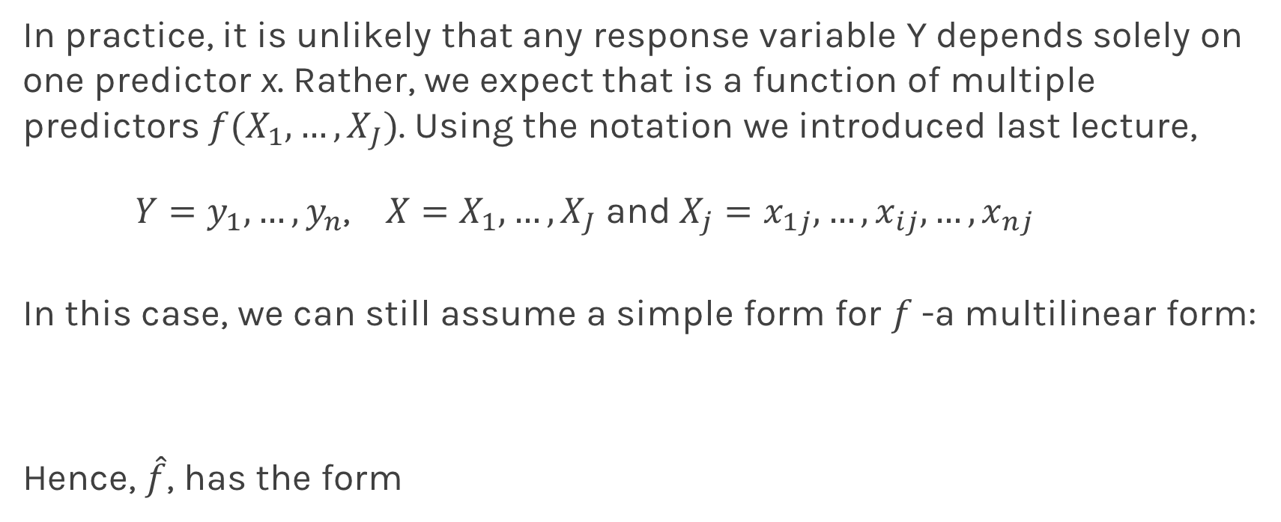
Multilinear Models
In practice, it is unlikely that any response variable Y depends solely on one predictor x. Rather, we expect that is a function of multiple predictors $f(X_{1},…,X_{J})$. Using the notation we introduced last lecture,
$Y=y_{1},…,y_{n}$, $X=X_{1},…,X_{J}$and$X_{j}=x_{1j},…,x_{ij},…,x_{nj}$
In this case, we can still assume a simple form for $f$-a multilinear form:
Hence, $\hat{f}$, has the form

Slide 8
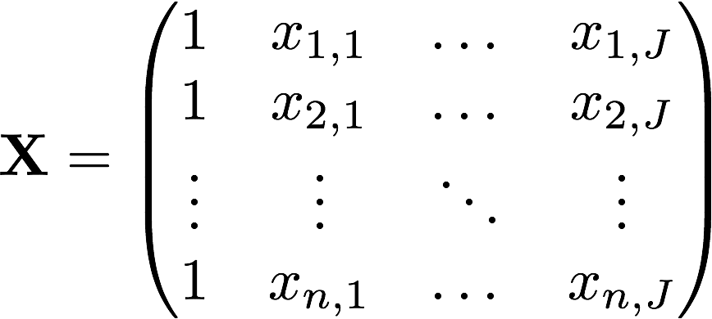
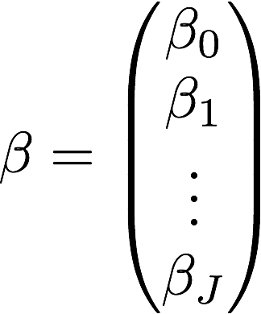
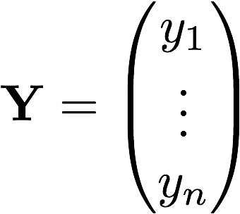
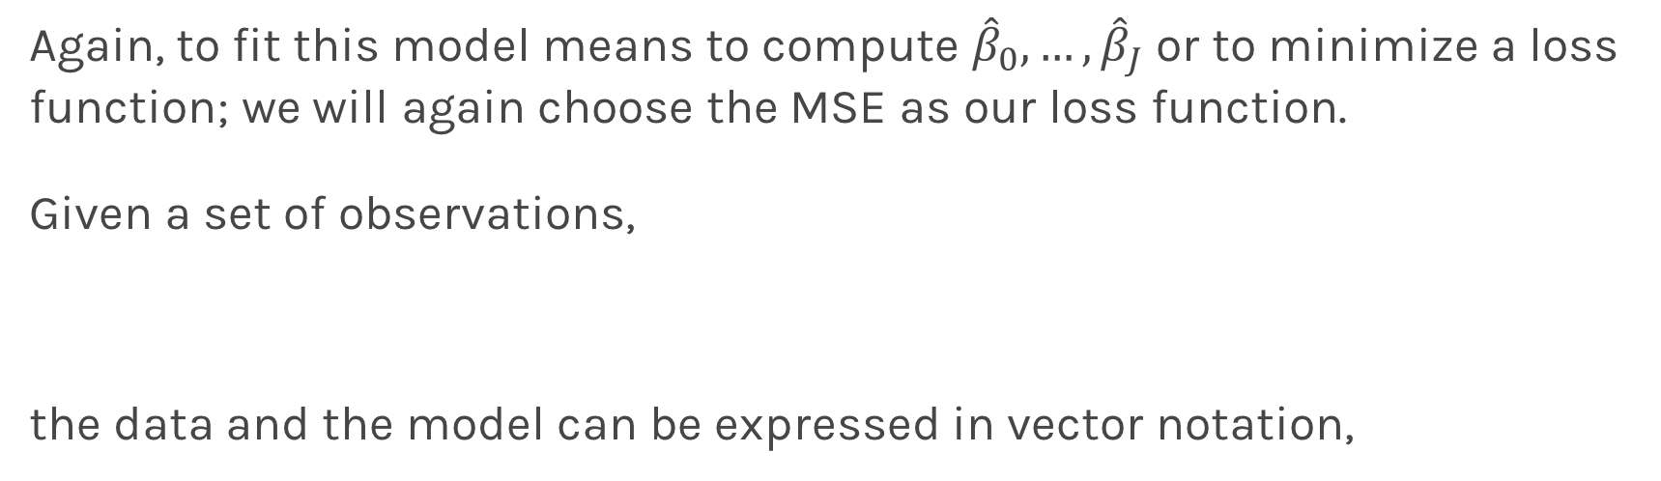
Multiple Linear Regression
Again, to fit this model means to compute ${\hat{β}}_{0},…,{\hat{β}}_{J}$ or to minimize a loss function; we will again choose the MSE as our loss function.
Given a set of observations,
the data and the model can be expressed in vector notation,
Notes:
We need a figure here

Slide 9
Multiple Linear Regression
The model takes a simple algebraic form:
Thus, the MSE can be expressed in vector notation as
Minimizing the MSE using vector calculus yields,
Notes:
We need a figure here

Slide 10
Collinearity
Collinearity refers to the case in which two or more predictors are correlated (related).
We will re-visit collinearity in the next lectures, but for now we want to examine how does collinearity affects our confidence on the coefficients and consequently on the importance of those coefficients.
First let’s look some examples:
Notes:
We need a figure here

Slide 11
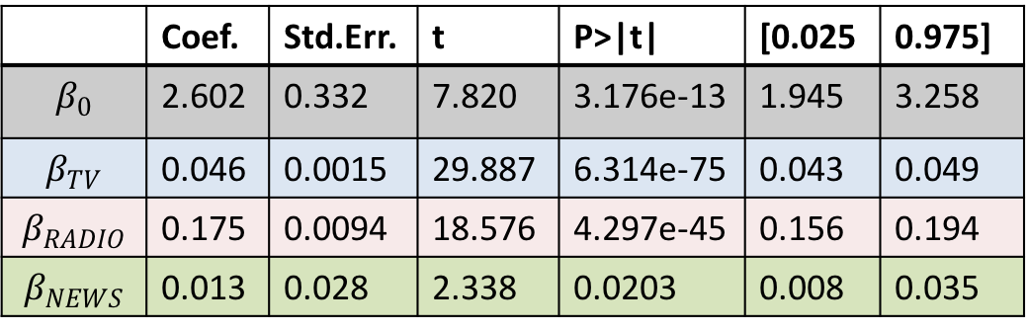
Collinearity
Three individual models
One model
TV
Coef. | Std.Err. | t | P>|t| | [0.025 | 0.975]
6.679 | 0.478 | 13.957 | 2.804e-31 | 5.735 | 7.622
0.048 | 0.0027 | 17.303 | 1.802e-41 | 0.042 | 0.053
RADIO
 | Coef. | Std.Err. | t | P>|t| | [0.025 | 0.975]
$$β_{0}$$ | 2.602 | 0.332 | 7.820 | 3.176e-13 | 1.945 | 3.258
$$β_{TV}$$ | 0.046 | 0.0015 | 29.887 | 6.314e-75 | 0.043 | 0.049
$$β_{RADIO}$$ | 0.175 | 0.0094 | 18.576 | 4.297e-45 | 0.156 | 0.194
$$β_{NEWS}$$ | 0.013 | 0.028 | 2.338 | 0.0203 | 0.008 | 0.035
Coef. | Std.Err. | t | P>|t| | [0.025 | 0.975]
9.567 | 0.553 | 17.279 | 2.133e-41 | 8.475 | 10.659
0.195 | 0.020 | 9.429 | 1.134e-17 | 0.154 | 0.236
NEWS
Coef. | Std.Err. | t | P>|t| | [0.025 | 0.975]
11.55 | 0.576 | 20.036 | 1.628e-49 | 10.414 | 12.688
0.074 | 0.014 | 5.134 | 6.734e-07 | 0.0456 | 0.102

Slide 12
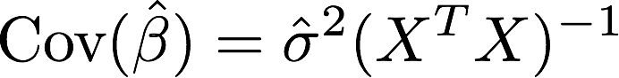
Collinearity
Collinearity refers to the case in which two or more predictors are correlated (related).
We will re-visit collinearity in the next lectures, but for now we want to examine how does collinearity affects our confidence on the coefficients and consequently on the importance of those coefficients.
Assuming uncorrelated noise then we can show:
Notes:
We need a figure here

Slide 13
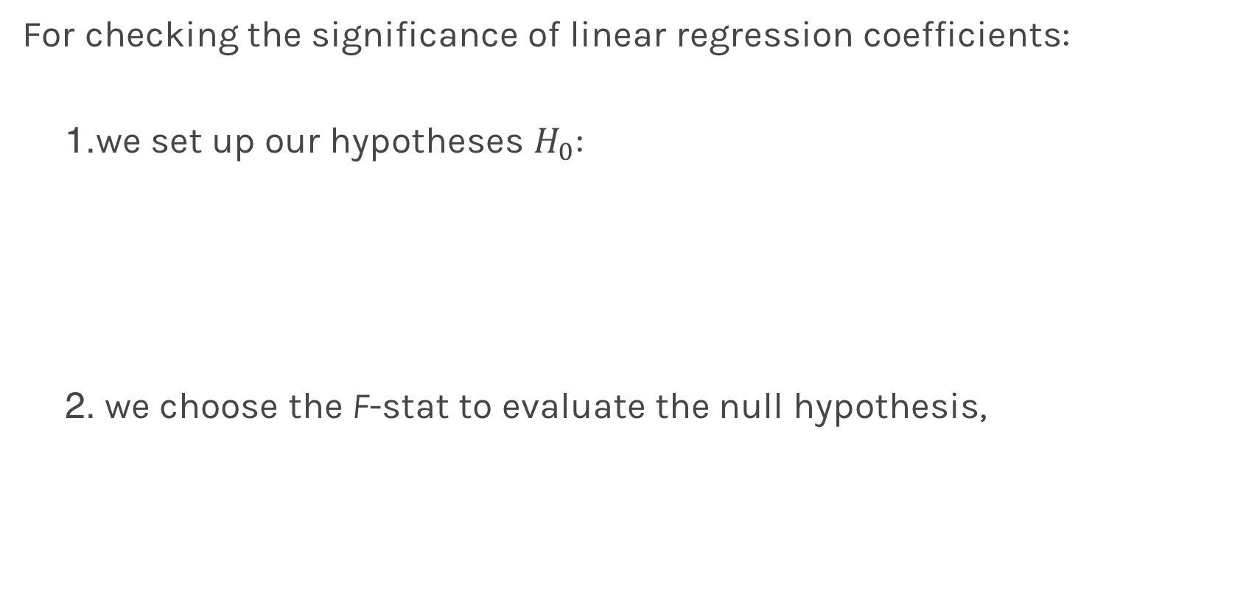
Finding Significant Predictors: Hypothesis Testing
For checking the significance of linear regression coefficients:
we set up our hypotheses $H_{0}$:
we choose the F-stat to evaluate the null hypothesis,

Slide 14
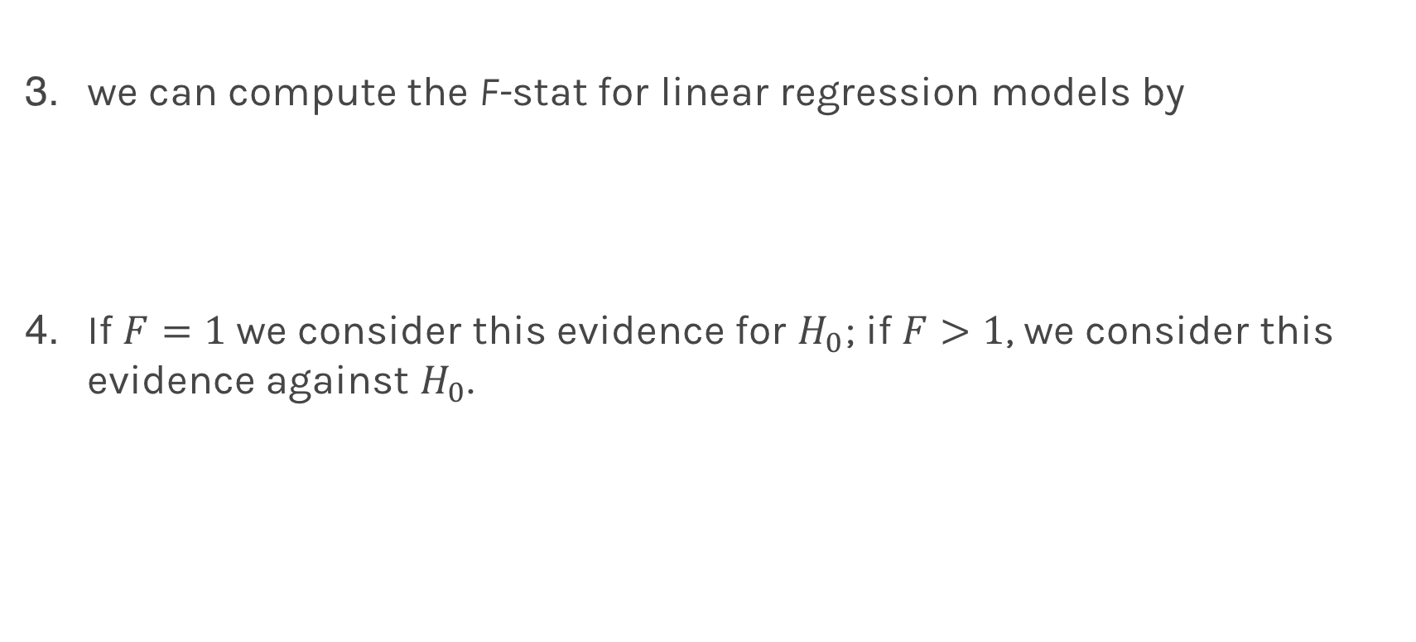
Finding Significant Predictors: Hypothesis Testing
we can compute the F-stat for linear regression models by
If $F=1$ we consider this evidence for $H_{0}$; if $F>1$, we consider this evidence against $H_{0}$.
Notes:
If F = 1, then y hat = mean of y (e.g., bad model)

Slide 15
Qualitative Predictors
So far, we have assumed that all variables are quantitative. But in practice, often some predictors are qualitative.
Example: The Credit data set contains information about balance, age, cards, education, income, limit , and rating for a number of potential customers.
Income | Limit | Rating | Cards | Age | Education | Gender | Student | Married | Ethnicity | Balance
14.890 | 3606 | 283 | 2 | 34 | 11 | Male | No | Yes | Caucasian | 333
106.02 | 6645 | 483 | 3 | 82 | 15 | Female | Yes | Yes | Asian | 903
104.59 | 7075 | 514 | 4 | 71 | 11 | Male | No | No | Asian | 580
148.92 | 9504 | 681 | 3 | 36 | 11 | Female | No | No | Asian | 964
55.882 | 4897 | 357 | 2 | 68 | 16 | Male | No | Yes | Caucasian | 331

Slide 16
Qualitative Predictors
If the predictor takes only two values, then we create an indicator or dummy variable that takes on two possible numerical values.
For example for the gender, we create a new variable:
We then use this variable as a predictor in the regression equation.
Notes:
One hot encoding

Slide 17
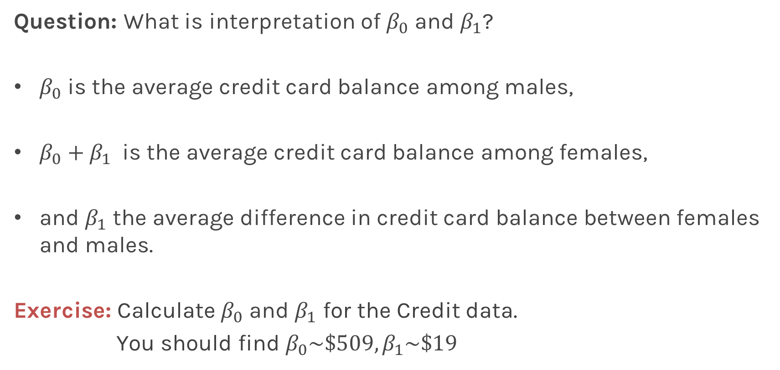
Qualitative Predictors
Question: What is interpretation of $β_{0}$ and $β_{1}$?
$β_{0}$ is the average credit card balance among males,
$β_{0}+β_{1}$ is the average credit card balance among females,
and $β_{1}$ the average difference in credit card balance between females and males.
Exercise: Calculate $β_{0}$ and $β_{1}$ for the Credit data.
You should find $β_{0}\sim \$509,β_{1}\sim \$19$

Slide 18
More than two levels: One hot encoding
Often, the qualitative predictor takes more than two values (e.g. ethnicity in the credit data).
In this situation, a single dummy variable cannot represent all possible values.
We create additional dummy variable as:
Notes:
The last category encoded in intercept

Slide 19
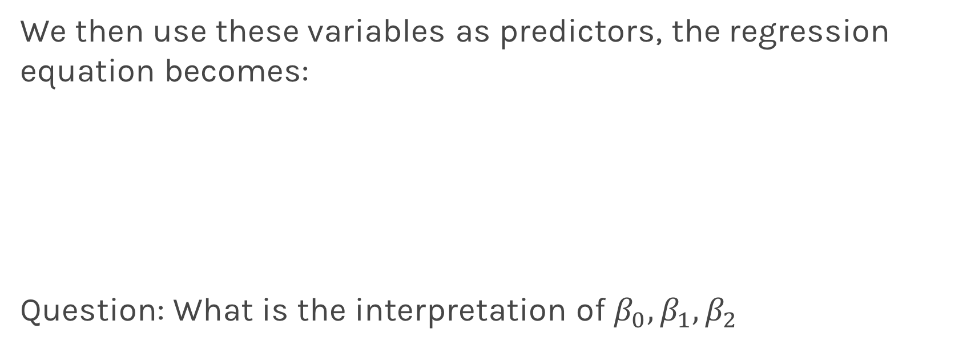
More than two levels: One hot encoding
We then use these variables as predictors, the regression equation becomes:
Question: What is the interpretation of $β_{0},β_{1},β_{2}$

Slide 20
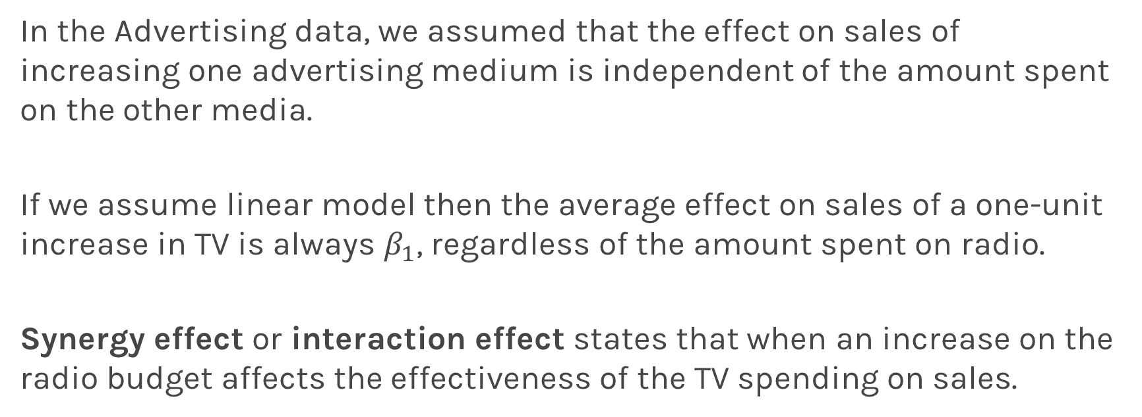
Beyond linearity
In the Advertising data, we assumed that the effect on sales of increasing one advertising medium is independent of the amount spent on the other media.
If we assume linear model then the average effect on sales of a one-unit increase in TV is always $β_{1}$, regardless of the amount spent on radio.
Synergy effect or interaction effect states that when an increase on the radio budget affects the effectiveness of the TV spending on sales.

Slide 21
Beyond linearity
We change
To
Notes:
Example with X2 to be ninary

Slide 22
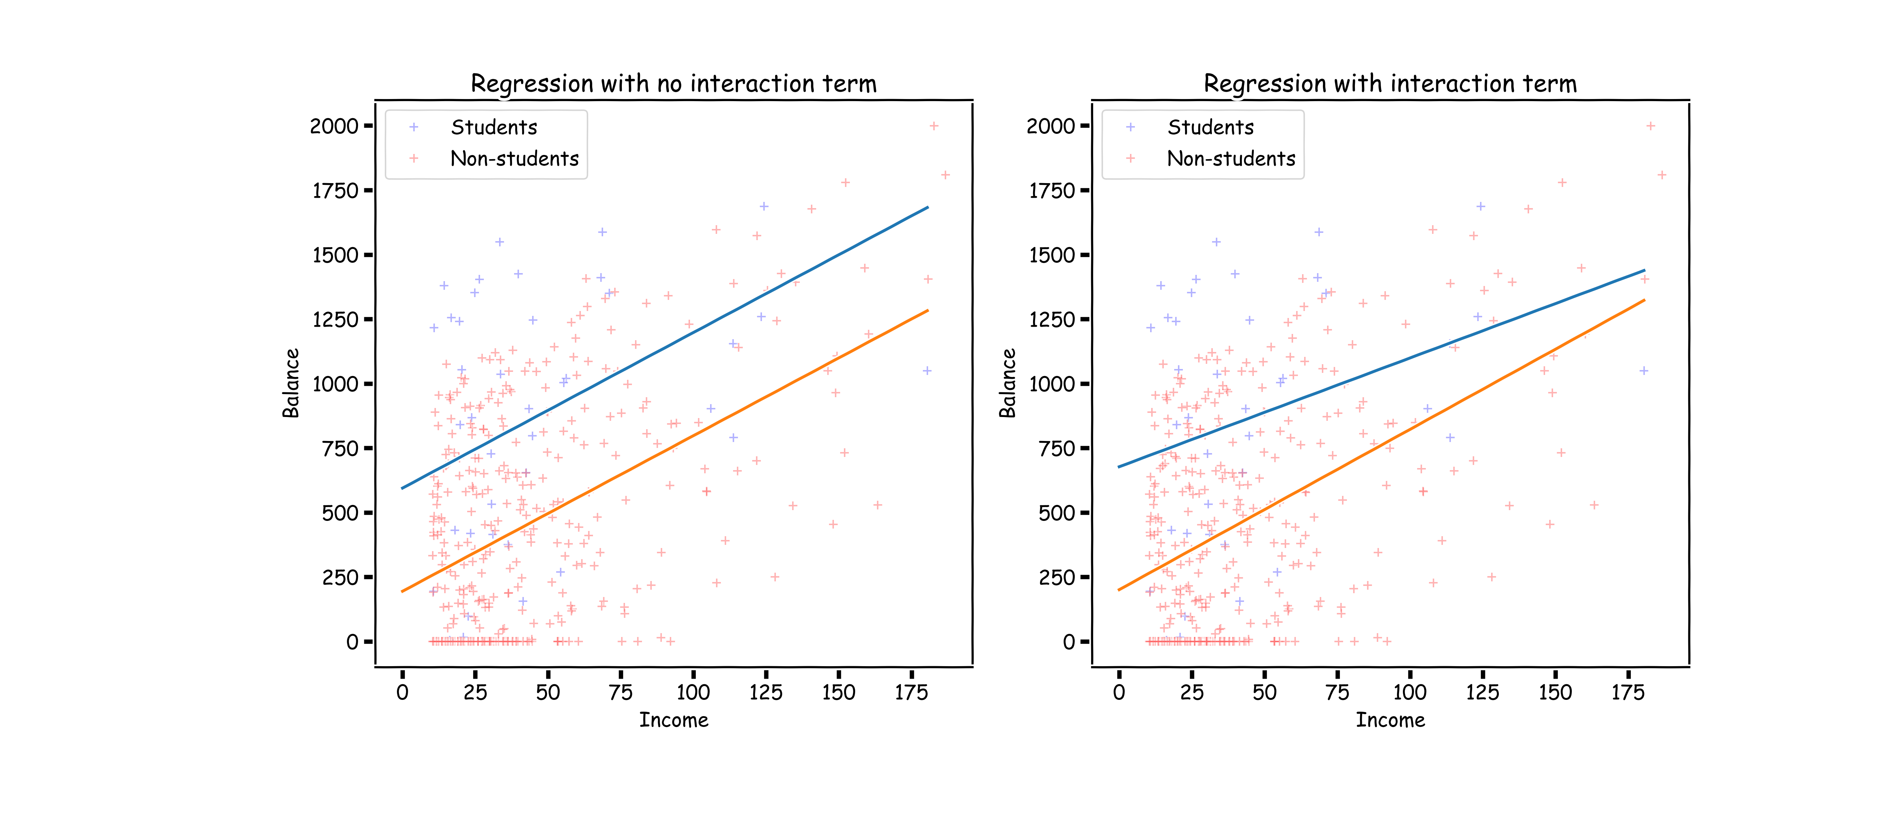
Question: Explain the plots above?
Notes:
Slope changes with interaction term (because B_1 & B_3 are both slopes when X1 != 0)
B_3: is the additional coefficients

Slide 23
Predictors predictors predictors
We have a lot predictors!
Is it a problem?
Yes: Computational Cost
Yes: Overfitting
Wait there is more …

Slide 24
Polynomial Regression

Slide 25
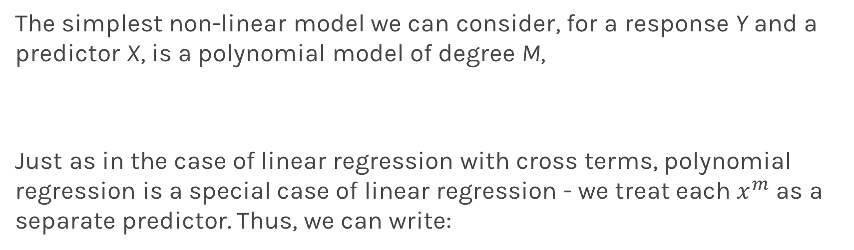
Polynomial Regression
The simplest non-linear model we can consider, for a response Y and a predictor X, is a polynomial model of degree M,
Just as in the case of linear regression with cross terms, polynomial regression is a special case of linear regression - we treat each $x^{m}$ as a separate predictor. Thus, we can write:

Slide 26
Polynomial Regression
Design Matrix
Again, minimizing the MSE using vector calculus yields,

Slide 27
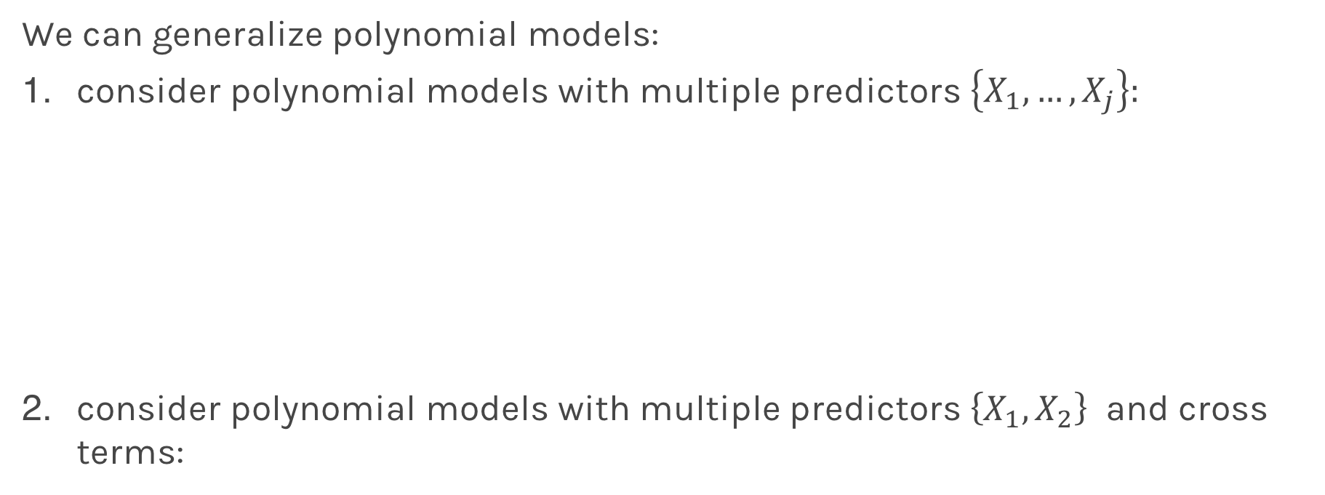
Generalized Polynomial Regression
We can generalize polynomial models:
consider polynomial models with multiple predictors $\left\{X_{1}, …, X_{j}\right\}:$
consider polynomial models with multiple predictors $\left\{X_{1}, X_{2}\right\}$ and cross terms:

Slide 28
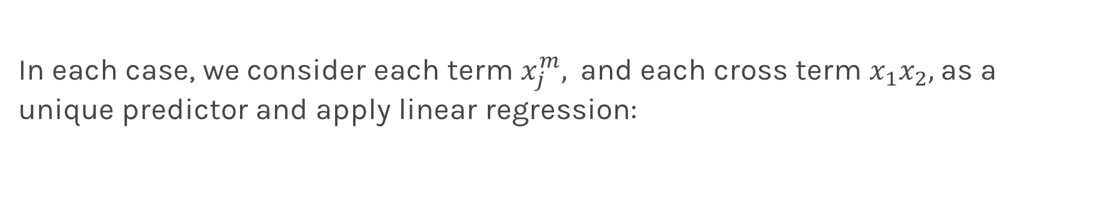
Generalized Polynomial Regression
In each case, we consider each term $x_{j}^{m},$and each cross term $x_{1}x_{2},$as a unique predictor and apply linear regression:

Slide 29
Model Selection
Model selection is the application of a principled method to determine the complexity of the model, e.g. choosing a subset of predictors, choosing the degree of the polynomial model etc.
A strong motivation for performing model selection is to avoid overfitting, which we can happen when:
there are too many predictors:
the feature space has high dimensionality
the polynomial degree is too high
too many cross terms are considered
the coefficients values are too extreme

Slide 30
Overfitting

Slide 31
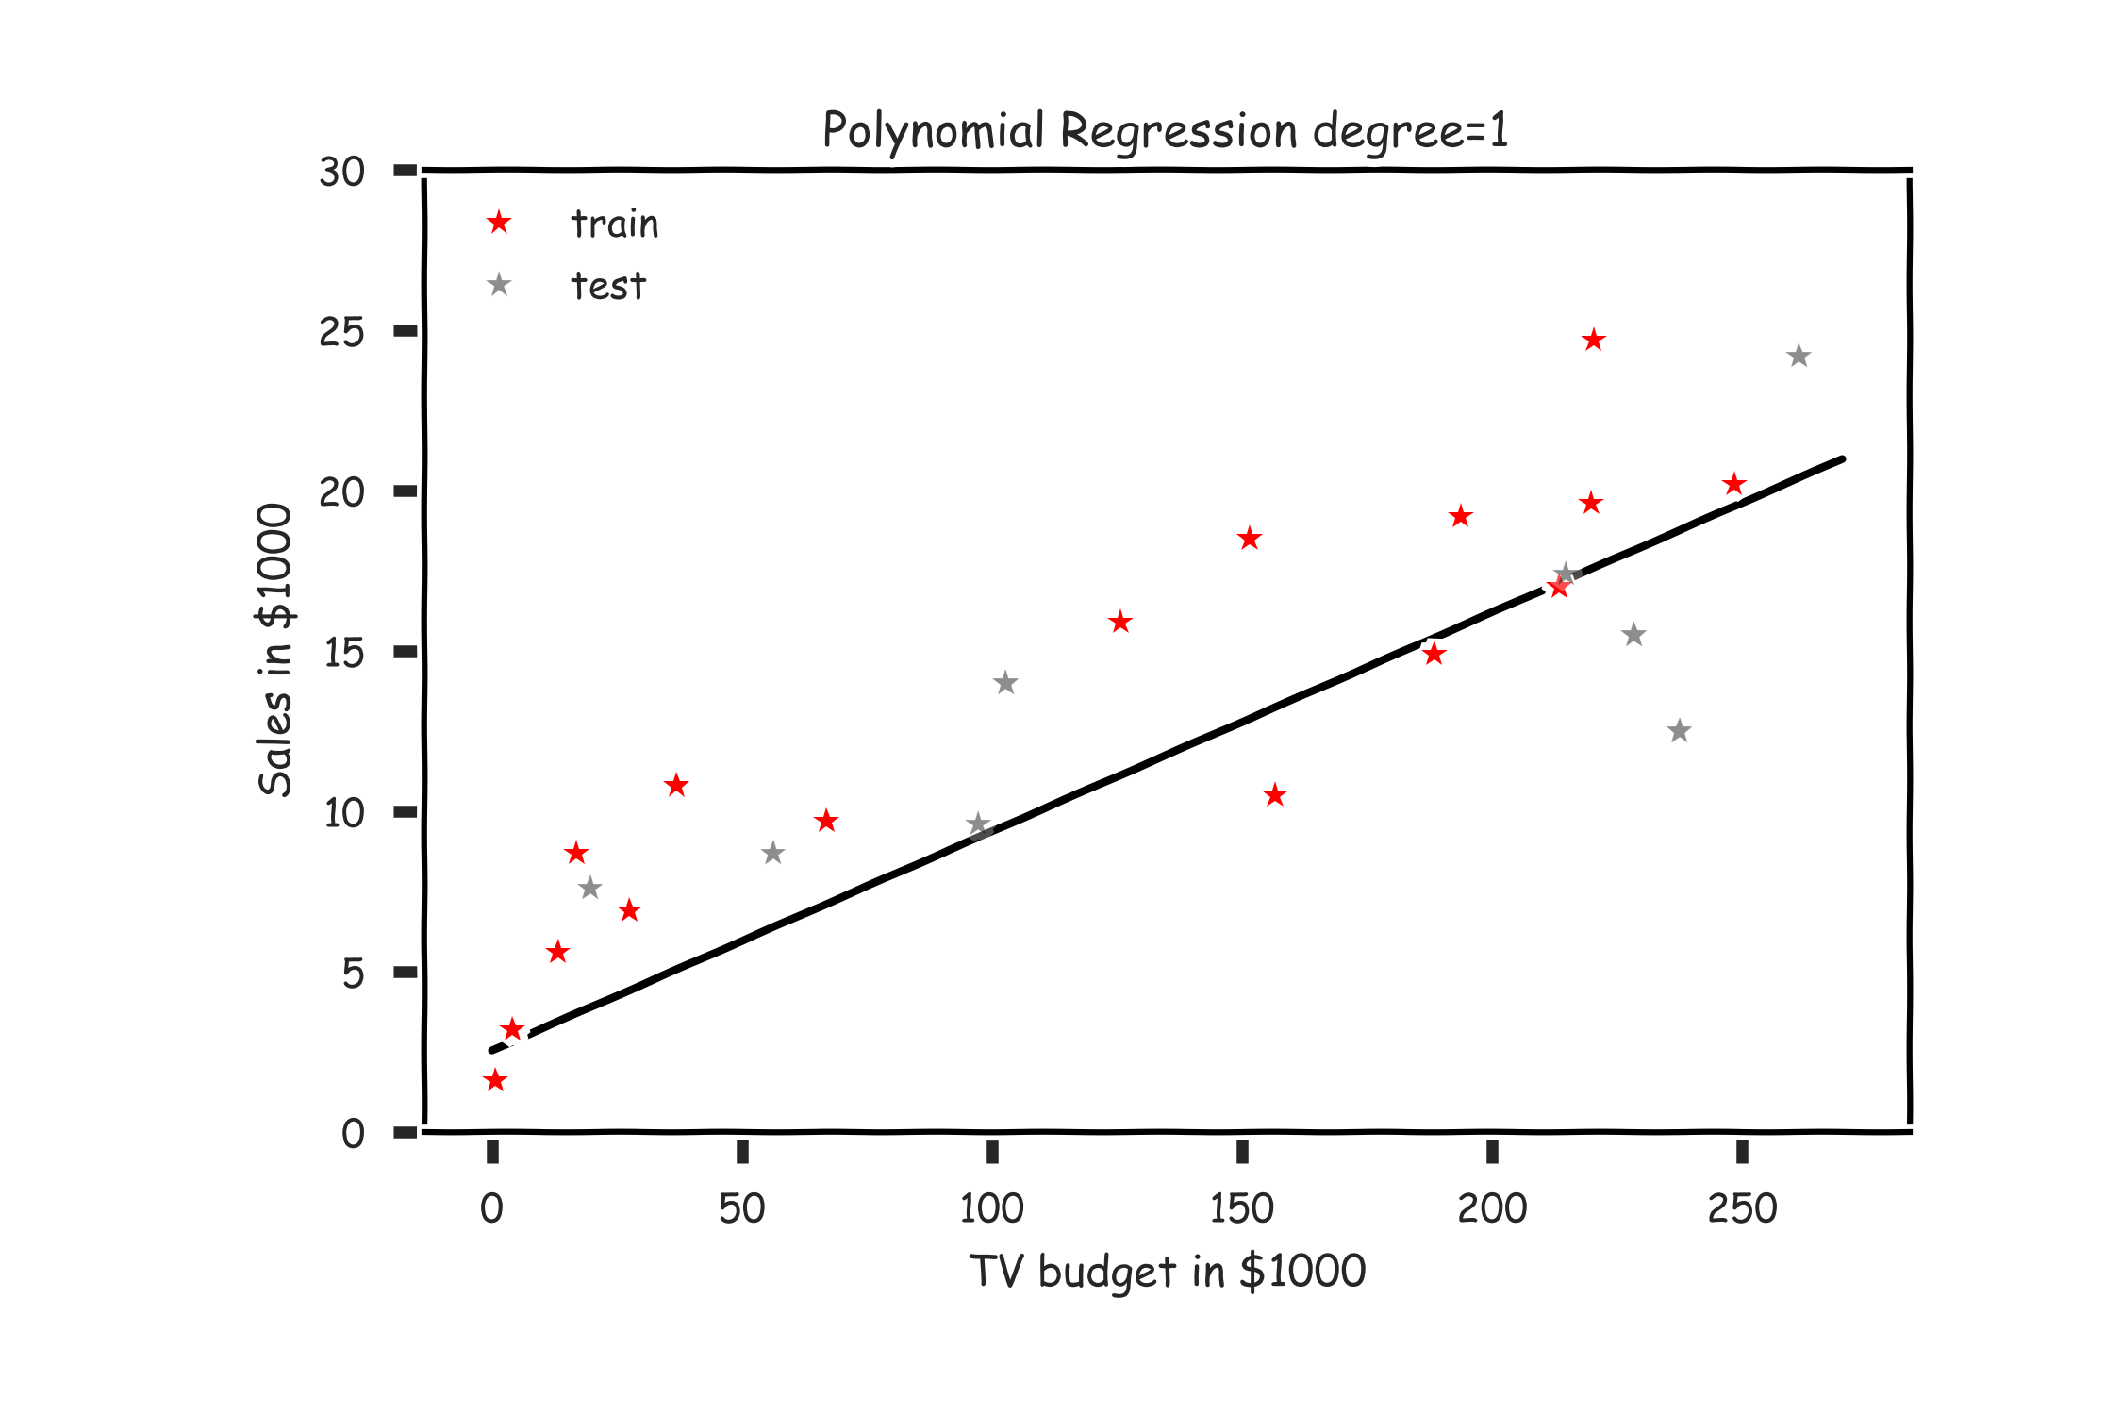
Overfitting

Slide 32
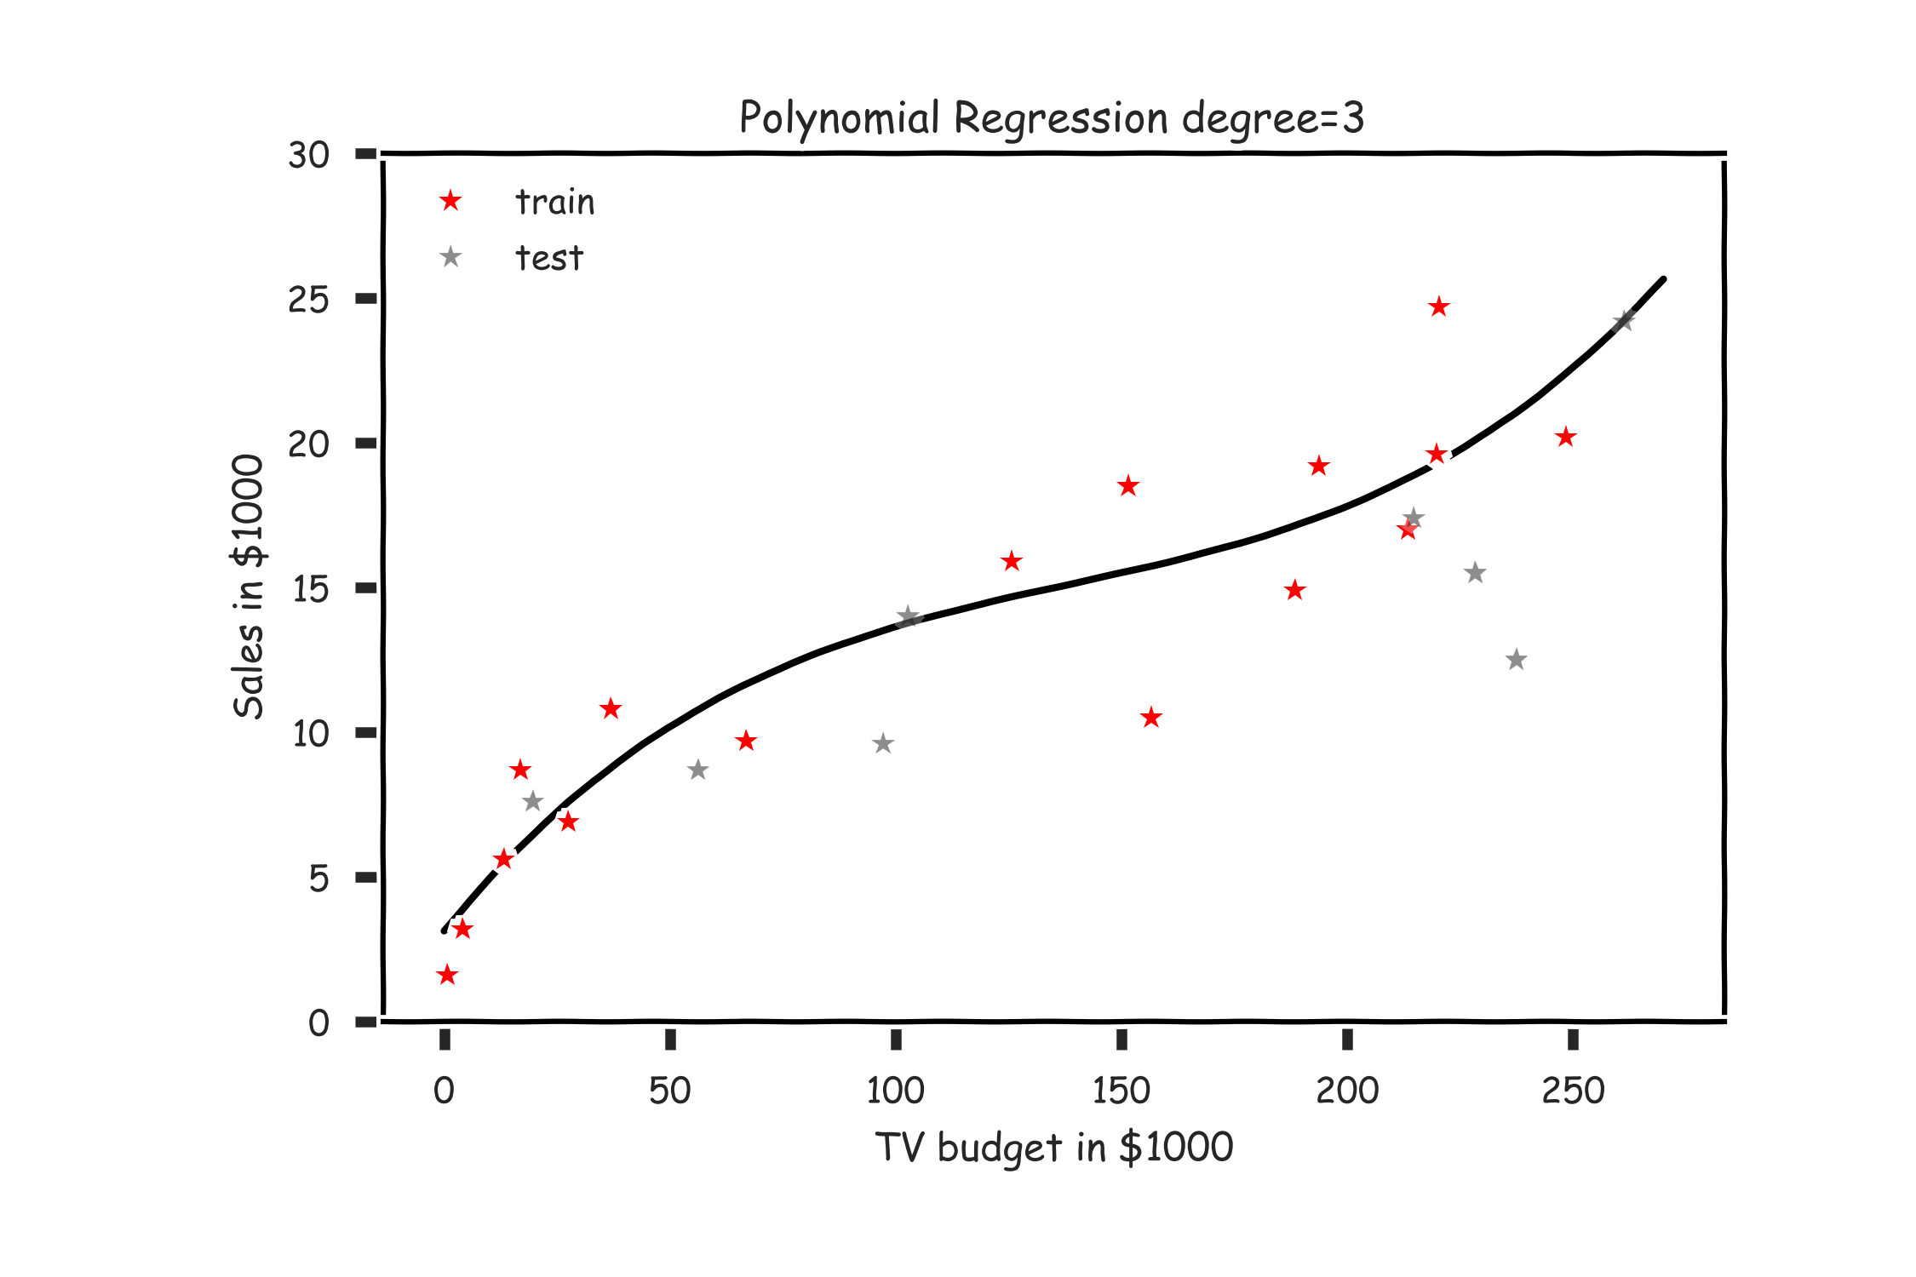
Overfitting

Slide 33
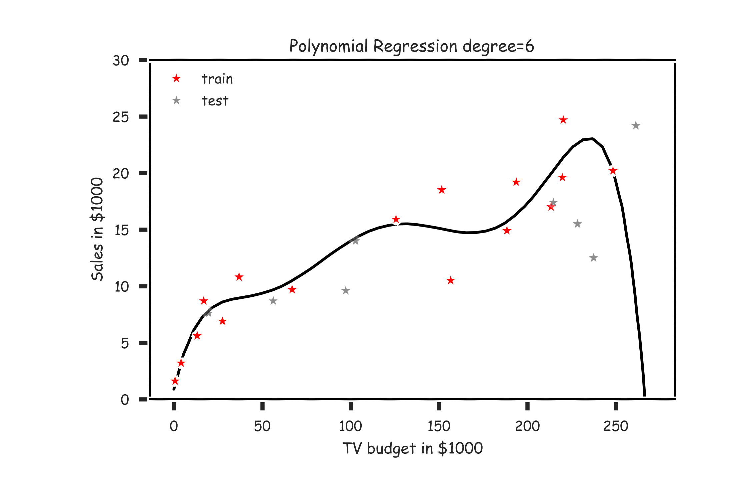
Overfitting

Slide 34
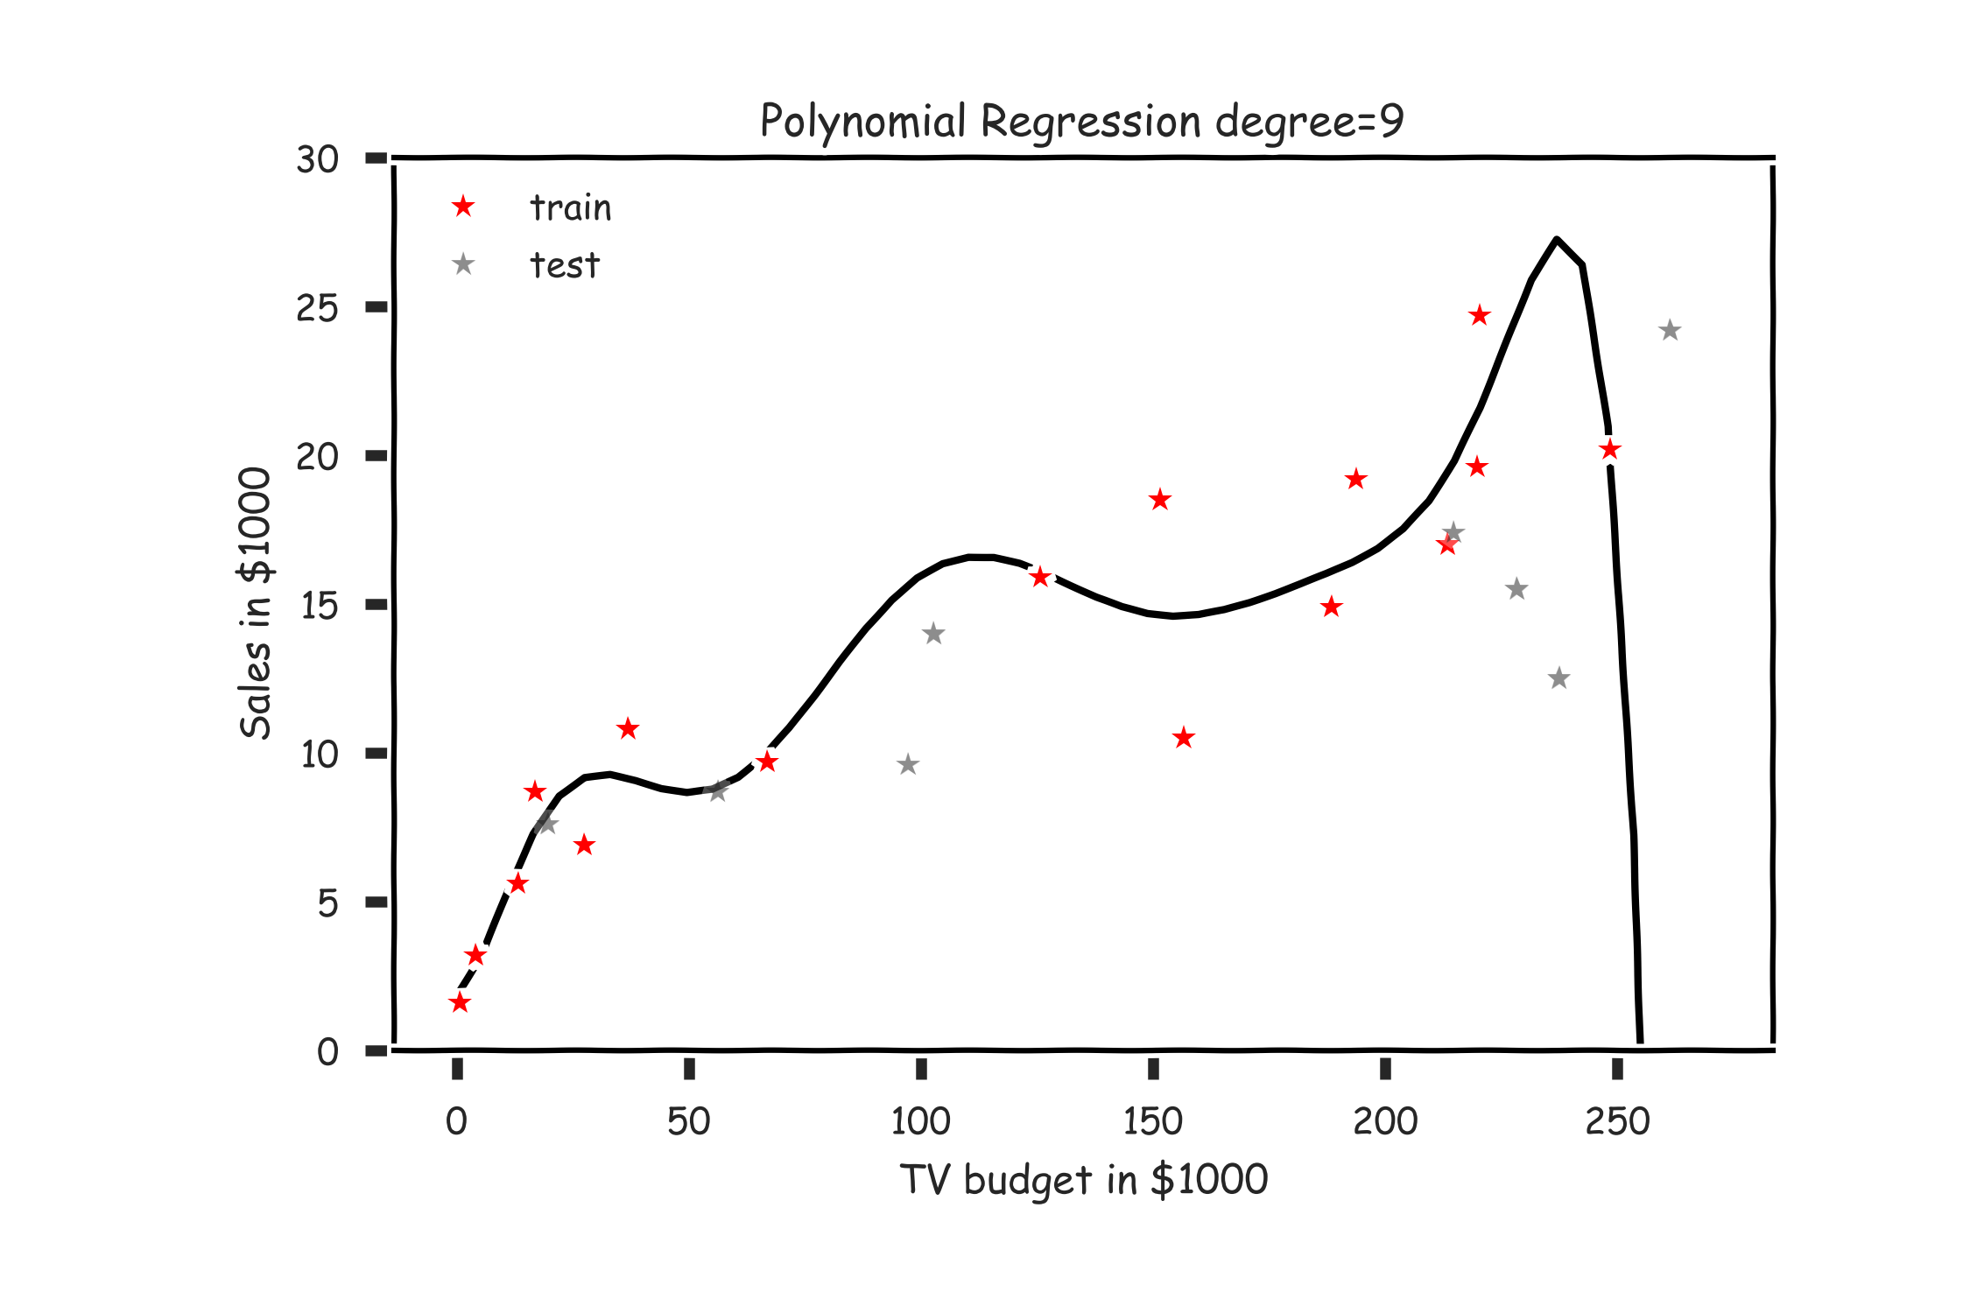
Overfitting

Slide 35
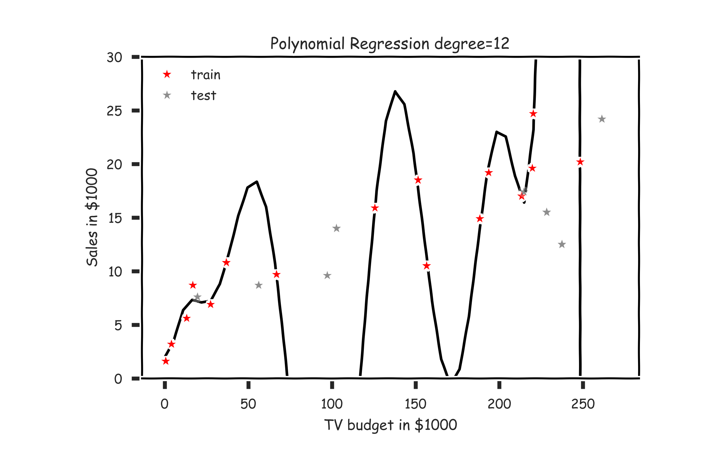
Overfitting

Slide 36
Overfitting
Definition
Overfitting is the phenomenon where the model is unnecessarily complex, in the sense that portions of the model captures the random noise in the observation, rather than the relationship between predictor(s) and response.
Overfitting causes the model to lose predictive power on new data.

Slide 37
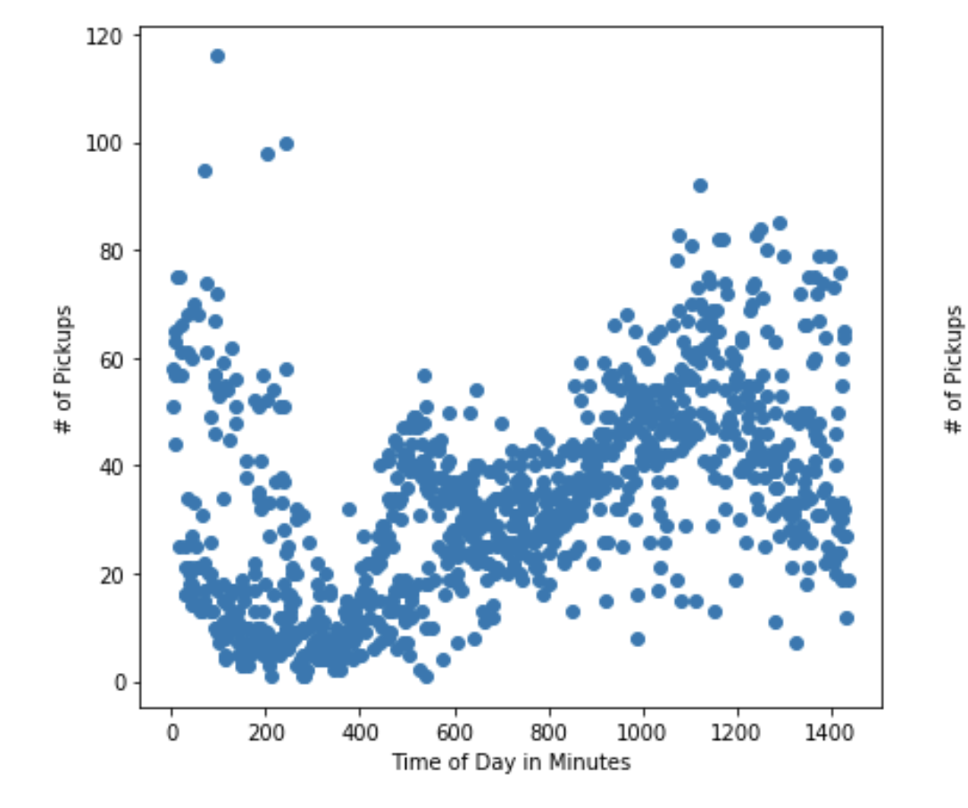
Notes:
Based on the data structure, what restriction on the model would you put at the endpoints (at x≈0x≈0 and x≈1440x≈1440)? What does this say about the linearity assumption?

Slide 38
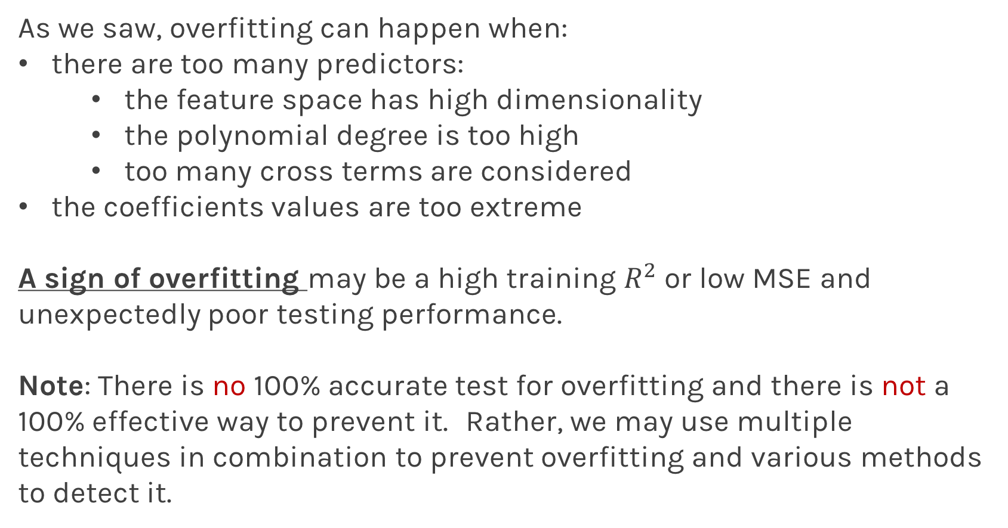
Overfitting
As we saw, overfitting can happen when:
there are too many predictors:
the feature space has high dimensionality
the polynomial degree is too high
too many cross terms are considered
the coefficients values are too extreme
A sign of overfitting may be a high training $R^{2}$ or low MSE and unexpectedly poor testing performance.
Note: There is no 100% accurate test for overfitting and there is not a 100% effective way to prevent it. Rather, we may use multiple techniques in combination to prevent overfitting and various methods to detect it.

Slide 39
Model Selection

Slide 40
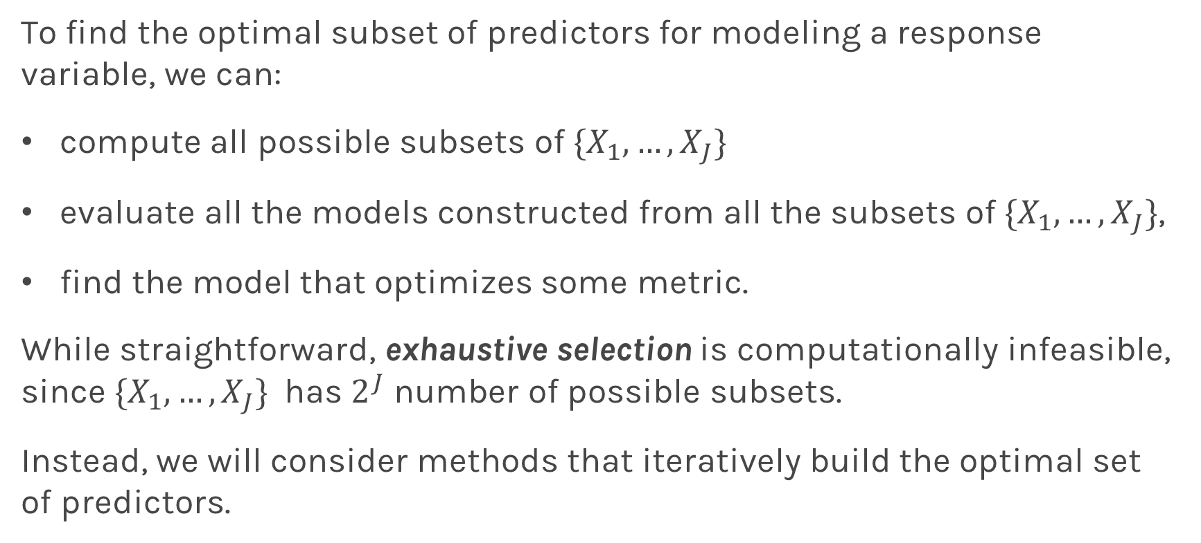
Exhaustive Selection
To find the optimal subset of predictors for modeling a response variable, we can:
compute all possible subsets of $\{X_{1},…,X_{J}\}$
evaluate all the models constructed from all the subsets of $\{X_{1},…,X_{J}\}$,
find the model that optimizes some metric.
While straightforward, exhaustive selection is computationally infeasible, since $\{X_{1},…,X_{J}\}$ has $2^{J}$ number of possible subsets.
Instead, we will consider methods that iteratively build the optimal set of predictors.
Notes:
2^J (with consideration of intercept)

Slide 41
Model selection
Model selection is the application of a principled method to determine the complexity of the model, e.g. choosing a subset of predictors, choosing the degree of the polynomial model etc.
Model selection typically consists of the following steps:
split the training set into two subsets: training and validation
multiple models (e.g. polynomial models with different degrees) are fitted on the training set; each model is evaluated on the validation set
the model with the best validation performance is selected
the selected model is evaluated one last time on the testing set

Slide 42
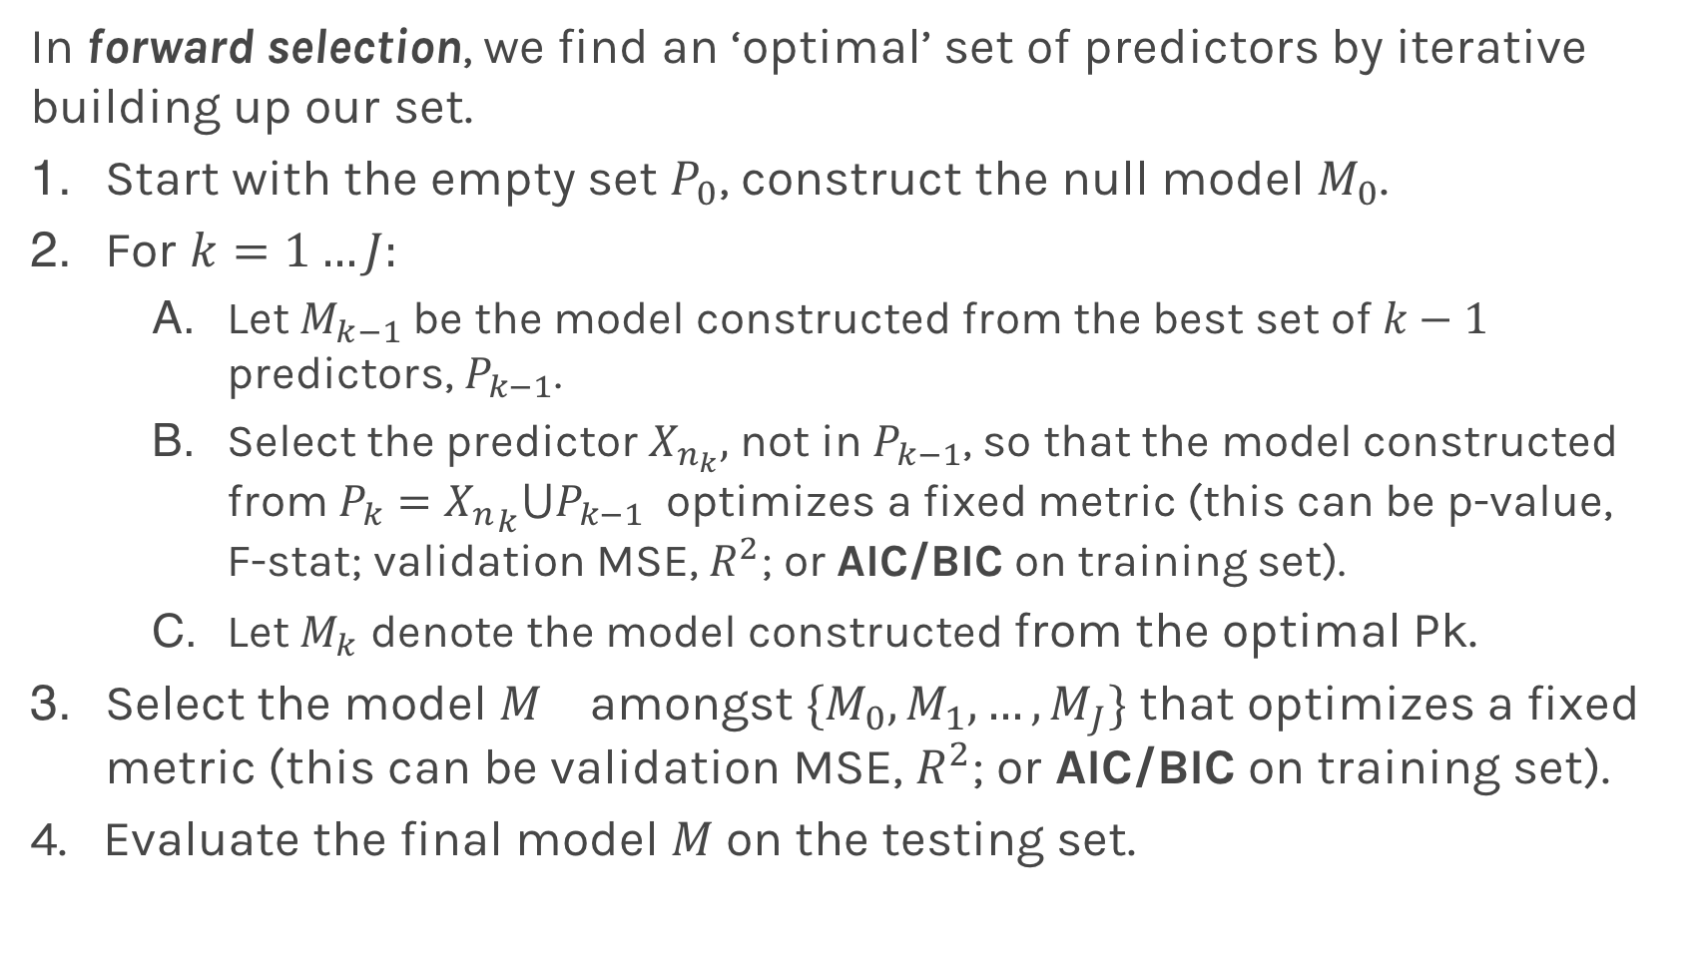
Variable Selection: Forward
In forward selection, we find an ‘optimal’ set of predictors by iterative building up our set.
Start with the empty set $P_{0}$, construct the null model $M_{0}$.
For $k=1…J:$
Let $M_{k−1}$be the model constructed from the best set of $k−1$ predictors, $P_{k−1}$.
Select the predictor $X_{n_{k}},$ not in $P_{k−1}$, so that the model constructed from $P_{k}={X_{n}}_{k}⋃P_{k−1}$ optimizes a fixed metric (this can be p-value, F-stat; validation MSE, $R^{2}$; or AIC/BIC on training set).
Let $M_{k}$ denote the model constructed from the optimal Pk.
Select the model $M_{}$ amongst ${\{M}_{0},M_{1}, …,M_{J}\}$ that optimizes a fixed metric (this can be validation MSE, $R^{2}$; or AIC/BIC on training set).
4. Evaluate the final model $M$on the testing set.

Slide 43
Stepwise Variable Selection Computational Complexity
How many models did we evaluate?
1st step, J Models
2nd step, J-1 Models (add 1 predictor out of J-1 possible)
3rd step, J-2 Models (add 1 predictor out of J-2 possible)
…

Slide 44
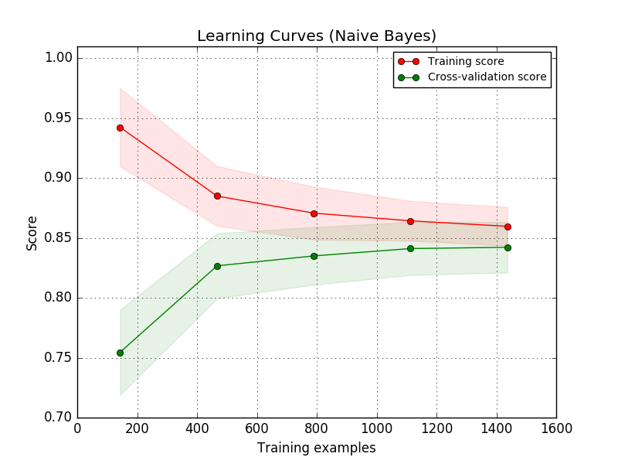
AIC and BIC – value of training data

Slide 45
AIC and BIC
In the absence of training data (we may not want to use valuable data for validation)
We’ve mentioned using AIC/BIC to evaluate the explanatory powers of models. The following formulae can be used to calculate these criteria:
where J is the number of predictors in model.
Intuitively, AIC/BIC is a loss function that depends both on the predictive error, MSE, and the complexity of the model. We see that we prefer a model with few parameters and low MSE.
But why do the formulae look this way - what is the justification? We will cover all that in A-sec2 today
Notes:
AIC: measures goodness of fit
n: sample size of training data?
Overtfitting happens when n is small relative to the # of predictors, J

Slide 46
Cross Validation

Slide 47
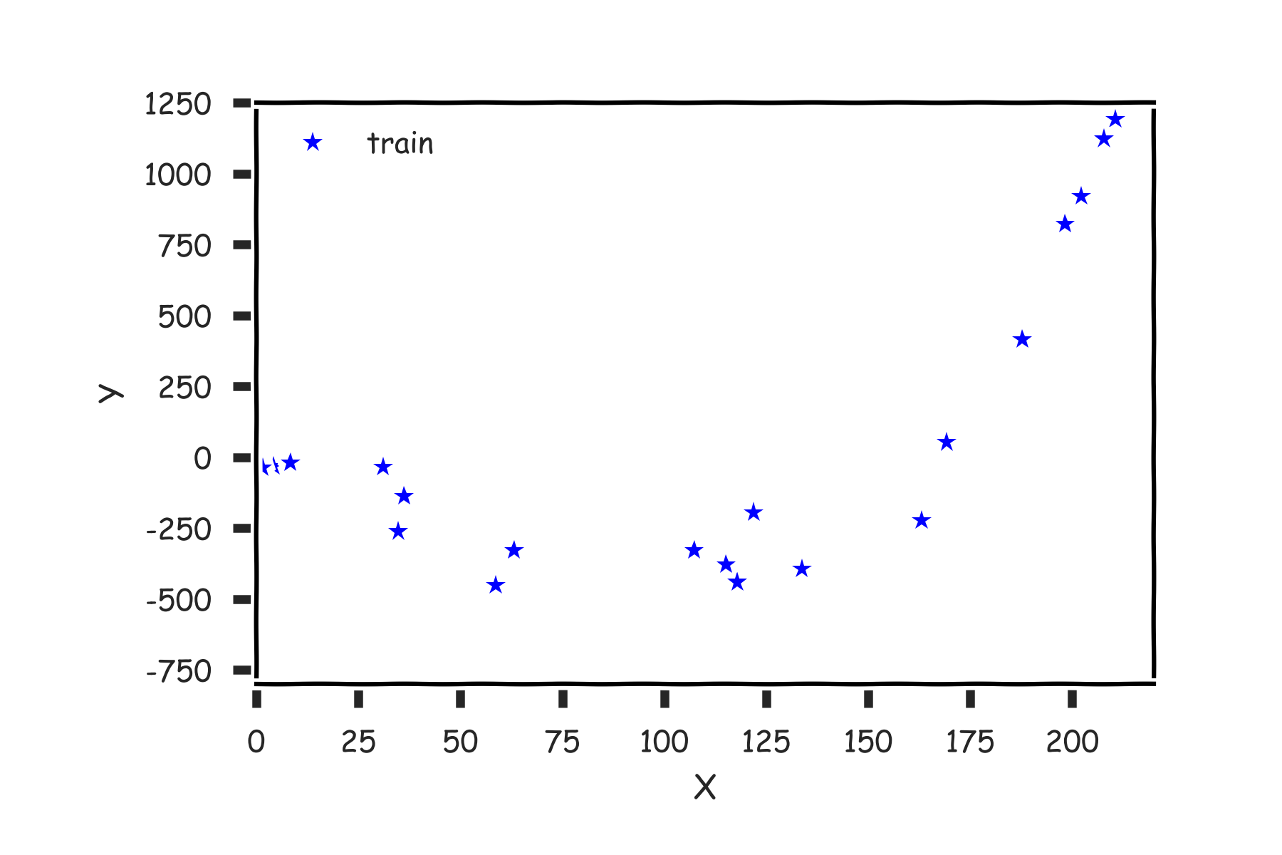
Cross Validation

Slide 48
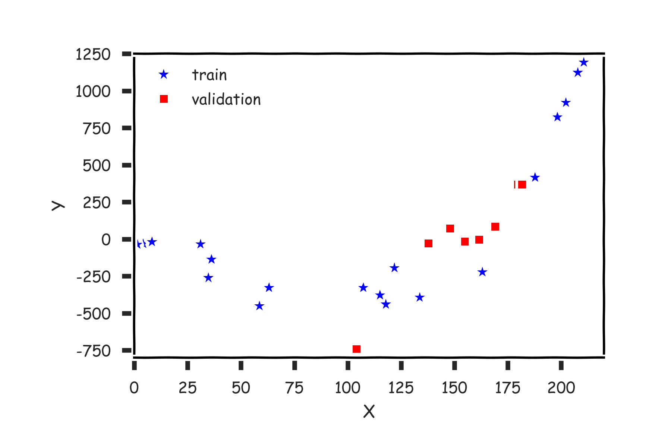
Cross Validation

Slide 49
Cross Validation
Linear
Quadratic

Slide 50
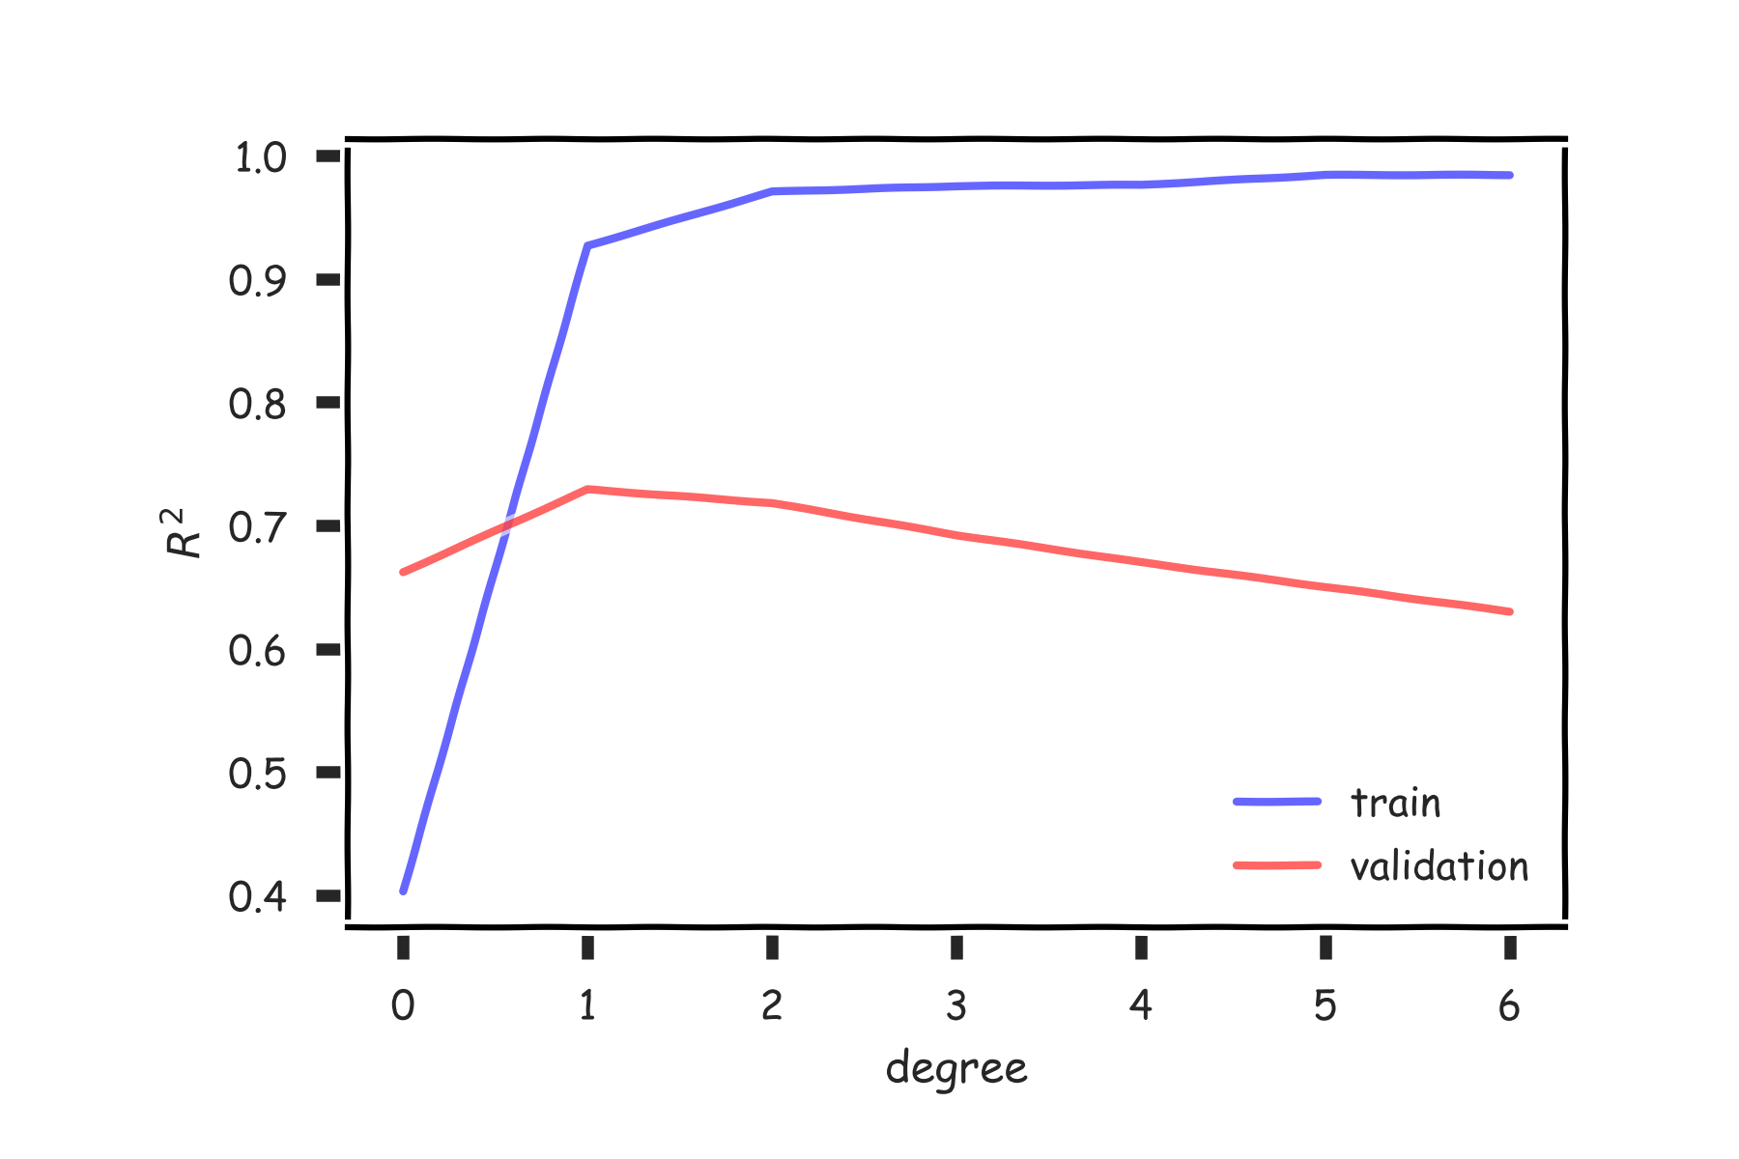
Validation

Slide 51
Cross Validation: Motivation
Using a single validation set to select amongst multiple models can be problematic - there is the possibility of overfitting to the validation set.
One solution to the problems raised by using a single validation set is to evaluate each model on multiple validation sets and average the validation performance.
One can randomly split the training set into training and validation multiple times but randomly creating these sets can create the scenario where important features of the data never appear in our random draws.

Slide 52
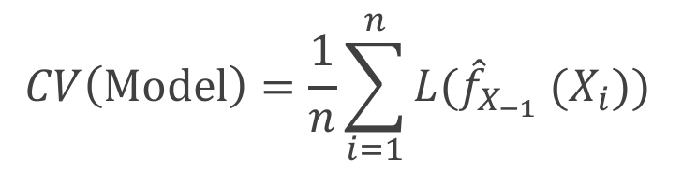
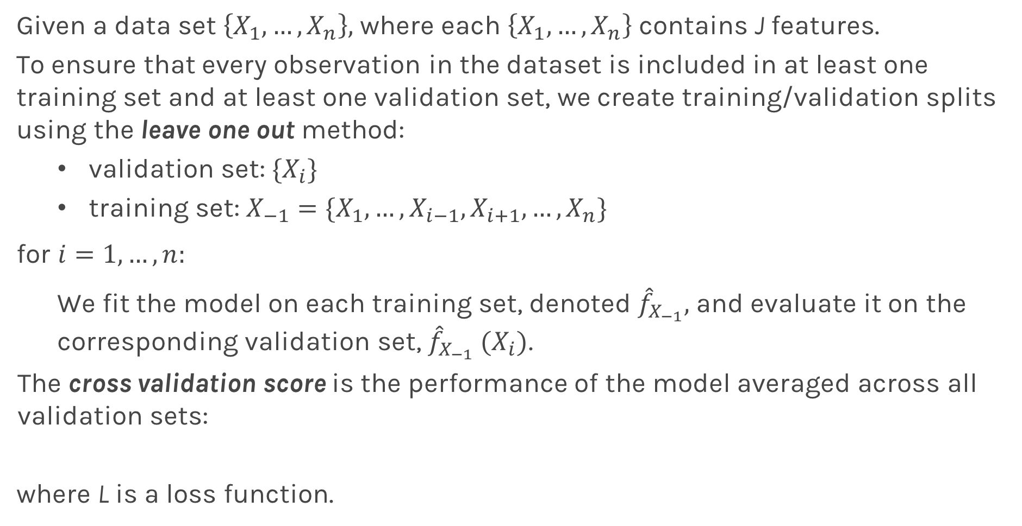
Leave-One-Out
Given a data set $\left\{X_{1},…,X_{n}\right\},$ where each $\left\{X_{1},…,X_{n}\right\}$ contains J features.
To ensure that every observation in the dataset is included in at least one training set and at least one validation set, we create training/validation splits using the leave one out method:
validation set: ${\{X}_{i}\}$
training set: $X_{−1}=\{X_{1}, …,X_{i−1},X_{i+1}, …, X_{n}\}$
for ${i=1,…,n: }_{}$
We fit the model on each training set, denoted ${\hat{f}}_{X_{−1}},$and evaluate it on the corresponding validation set, ${\hat{f}}_{X_{−1}} (X_{i})$.
The cross validation score is the performance of the model averaged across all validation sets:
where L is a loss function.
$$CV\left(Model\right)=\frac{1}{n}\sum_{i=1}^{n}{{L(\hat{f}}_{X_{−1}} (X_{i})\text{)} }$$

Slide 53
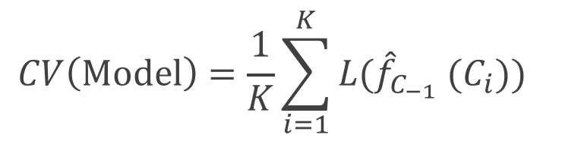
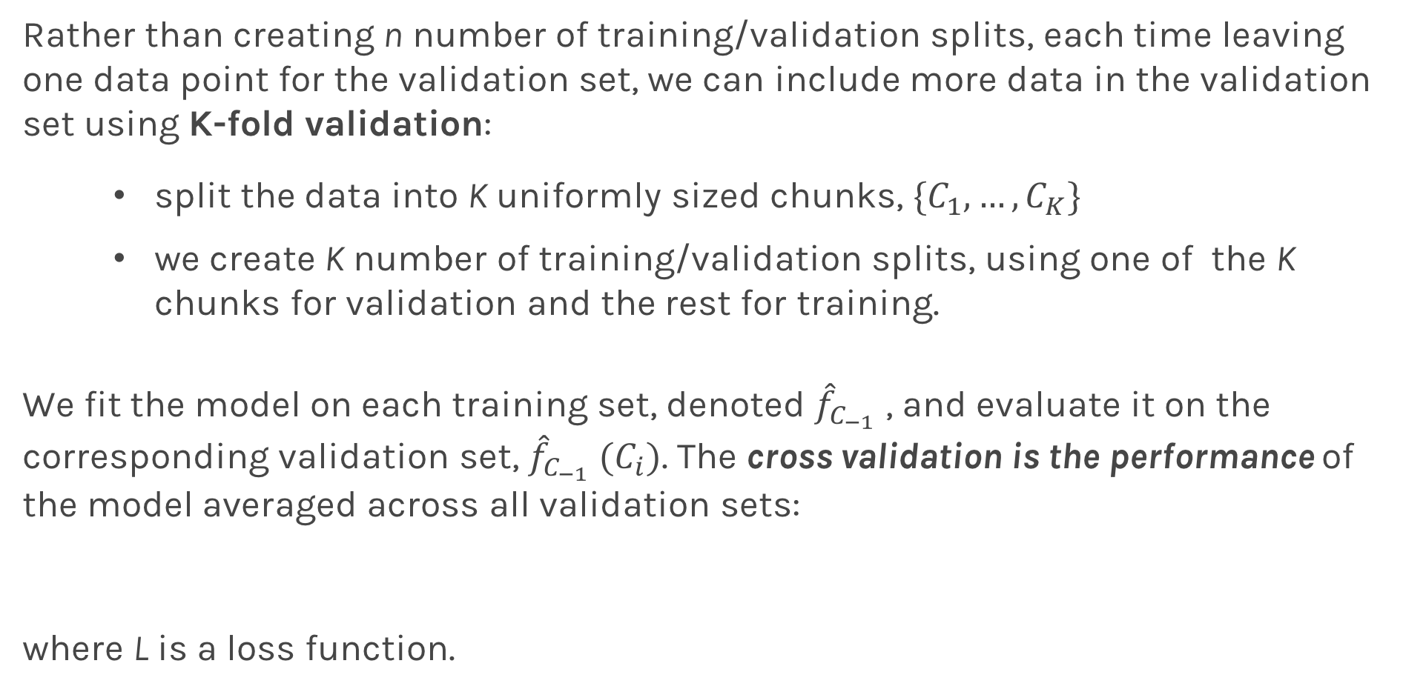
K-Fold Cross Validation
Rather than creating n number of training/validation splits, each time leaving one data point for the validation set, we can include more data in the validation set using K-fold validation:
split the data into K uniformly sized chunks, $\{C_{1},…,C_{K}\}$
we create K number of training/validation splits, using one of the K chunks for validation and the rest for training.
We fit the model on each training set, denoted ${\hat{f}}_{C_{−1}}$ , and evaluate it on the corresponding validation set, ${\hat{f}}_{C_{−1}} (C_{i})$. The cross validation is the performance of the model averaged across all validation sets:
where L is a loss function.
$$CV\left(Model\right)=\frac{1}{K}\sum_{i=1}^{K}{{L(\hat{f}}_{C_{−1}} (C_{i})\text{)} }$$

Slide 54
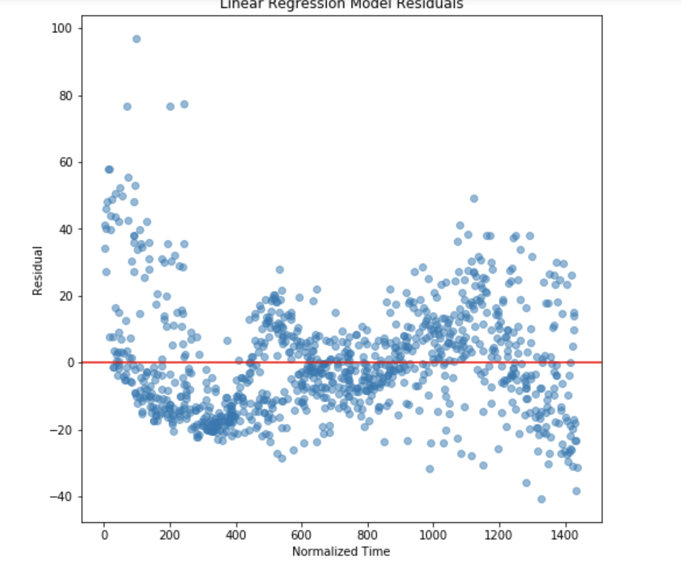
Notes:
Create a scatter plot of the residuals (e=y−ŷ e=y−y^) of the linear regression model on the training set as a function of the predictor variable (i.e. TimeMin). Place on your plot a horizontal line denoting the constant zero residual.

Slide 55
Cross Validation

Slide 56
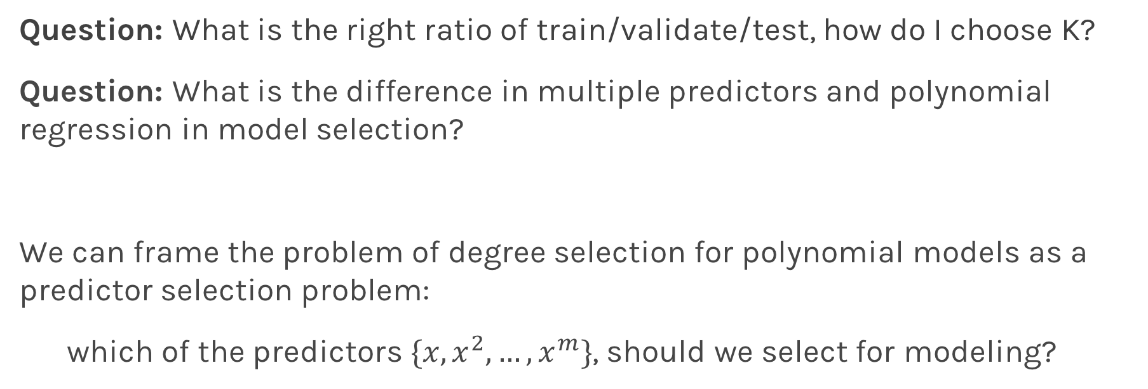
Predictor Selection: Cross Validation
Question: What is the right ratio of train/validate/test, how do I choose K?
Question: What is the difference in multiple predictors and polynomial regression in model selection?
We can frame the problem of degree selection for polynomial models as a predictor selection problem:
which of the predictors $\{x, x^{2},…, x^{m}\}$, should we select for modeling?

Slide 57

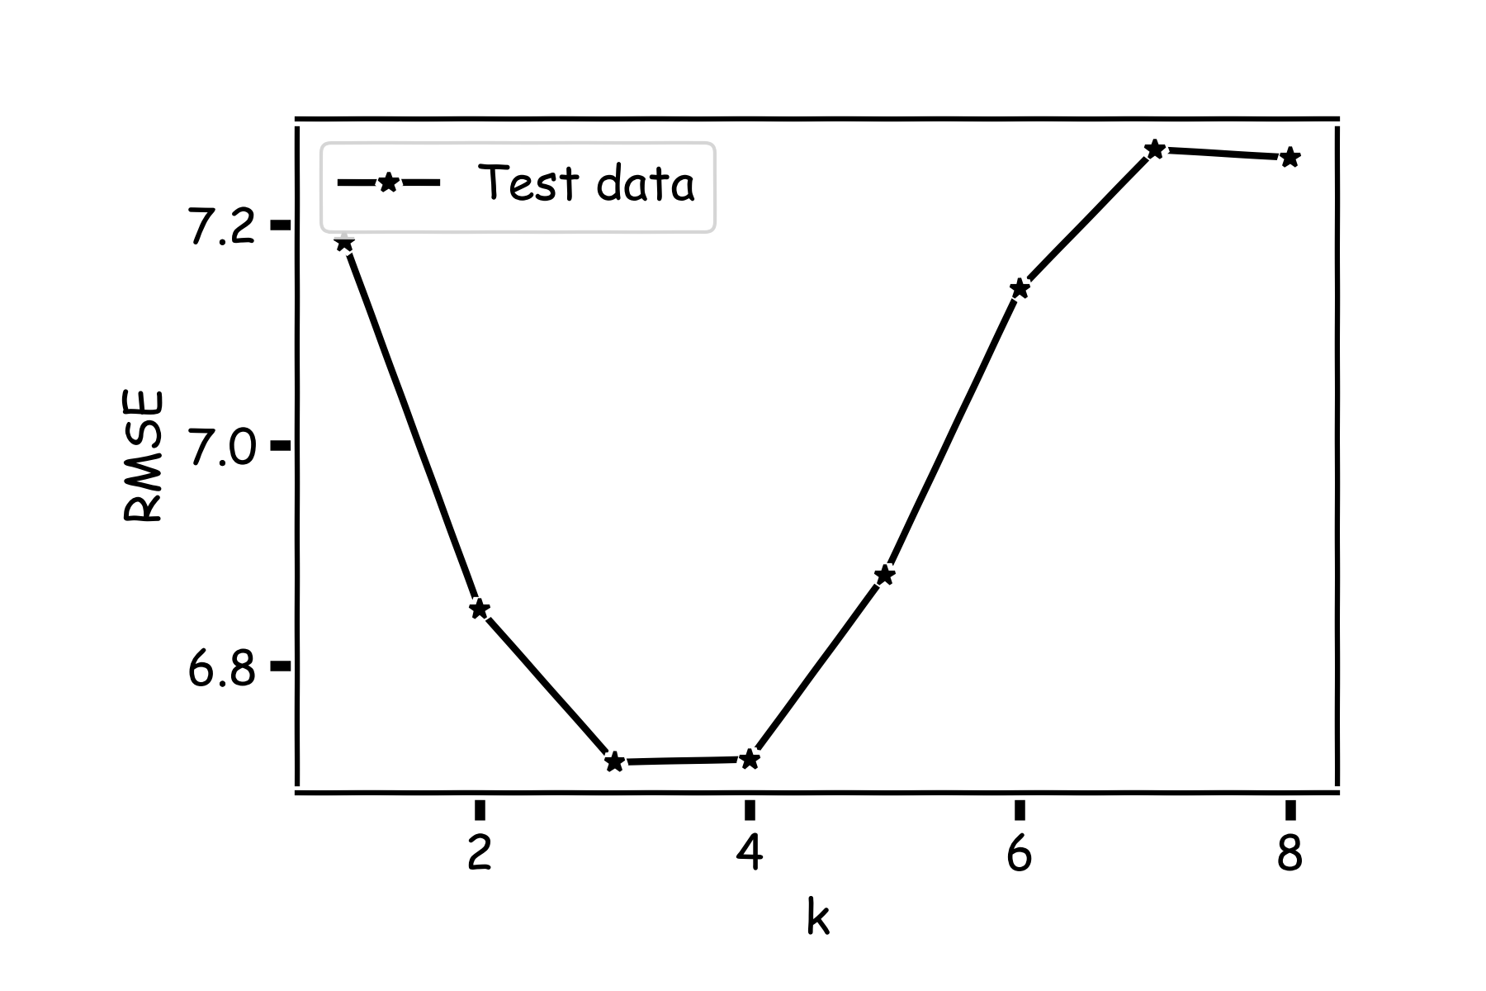
kNN Revisited

Slide 58
kNN Revisited
Recall our first simple, intuitive, non-parametric model for regression - the kNN model. We saw that it is vitally important to select an appropriate k for the data.
If the k is too small then the model is very sensitive to noise (since a new prediction is based on very few observed neighbors), and if the k is too large, the model tends towards making constant predictions.
A principled way to choose k is through K-fold cross validation.

Slide 59
Behind Ordinary Lease Squares, AIC, BIC

Slide 60
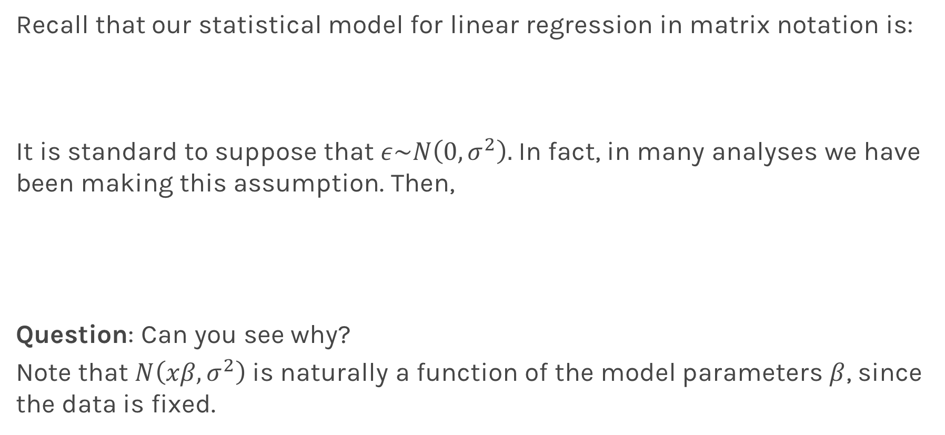
Likelihood Functions
Recall that our statistical model for linear regression in matrix notation is:
It is standard to suppose that $ε\sim N\left(0,σ^{2}\right).$In fact, in many analyses we have been making this assumption. Then,
Question: Can you see why?
Note that $N\left(xβ,σ^{2}\right)$ is naturally a function of the model parameters $β$, since the data is fixed.

Slide 61
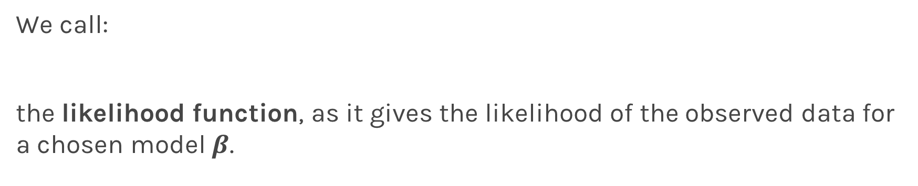
Likelihood Functions
We call:
the likelihood function, as it gives the likelihood of the observed data for a chosen model $β$.

Slide 62
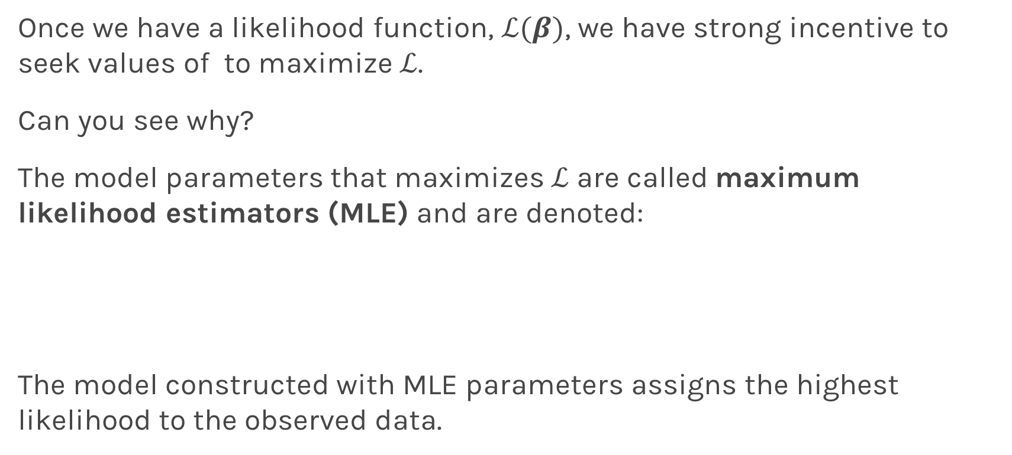
Maximum Likelihood Estimators
Once we have a likelihood function, $ℒ(β)$, we have strong incentive to seek values of to maximize $ℒ$.
Can you see why?
The model parameters that maximizes $ℒ$ are called maximum likelihood estimators (MLE) and are denoted:
The model constructed with MLE parameters assigns the highest likelihood to the observed data.

Slide 63
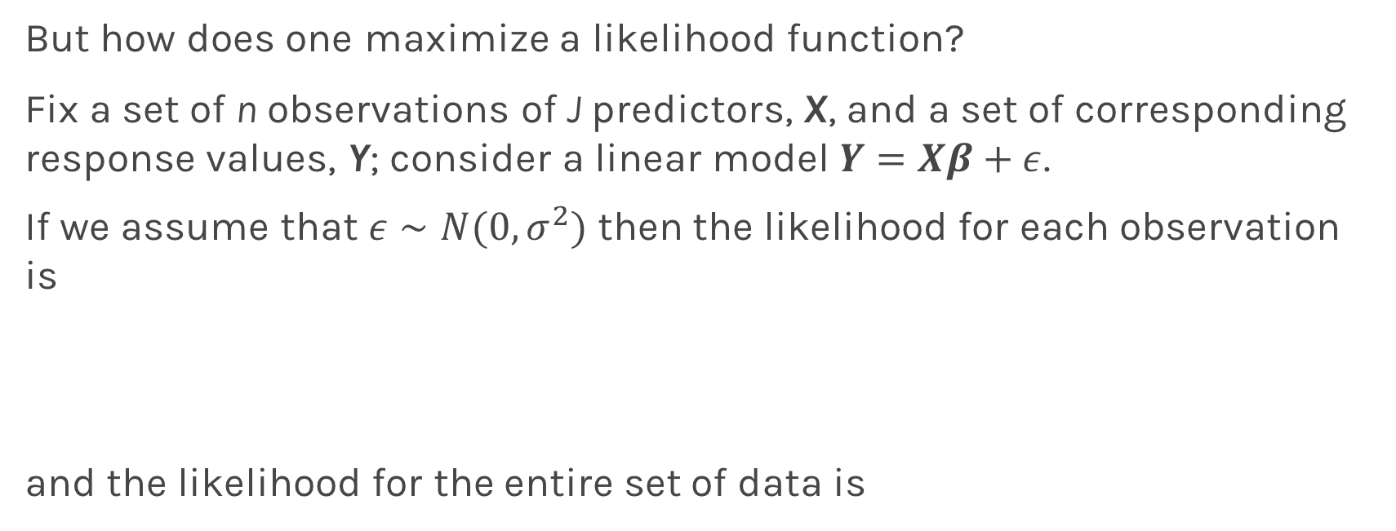
Maximum Likelihood Estimators
But how does one maximize a likelihood function?
Fix a set of n observations of J predictors, X, and a set of corresponding response values, Y; consider a linear model $Y=Xβ+ε$.
If we assume that $ε∼Ν(0,σ^{2})$ then the likelihood for each observation is
and the likelihood for the entire set of data is

Slide 64
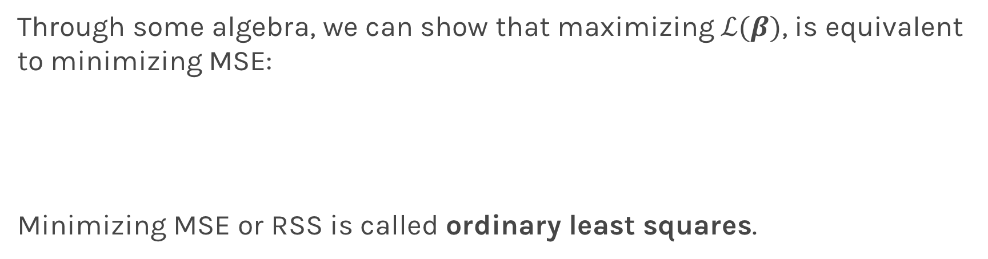
Maximum Likelihood Estimators
Through some algebra, we can show that maximizing $ℒ(β)$, is equivalent to minimizing MSE:
Minimizing MSE or RSS is called ordinary least squares.

Slide 65
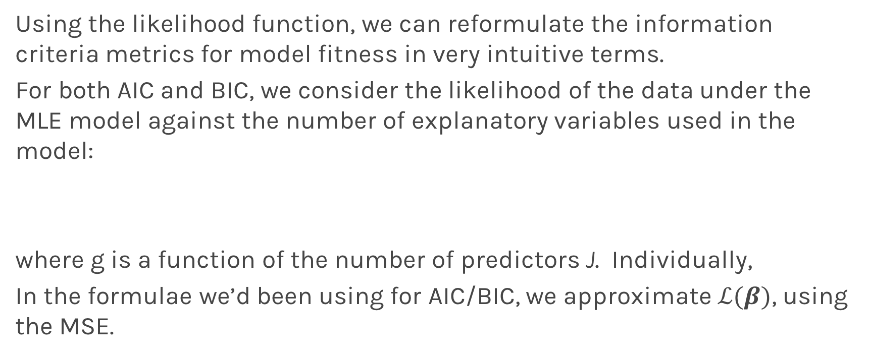
Information Criteria Revisited
Using the likelihood function, we can reformulate the information criteria metrics for model fitness in very intuitive terms.
For both AIC and BIC, we consider the likelihood of the data under the MLE model against the number of explanatory variables used in the model:
where g is a function of the number of predictors J. Individually,
In the formulae we’d been using for AIC/BIC, we approximate $ℒ(β)$, using the MSE.

